Slide 1
CS 412 Intro. to Data Mining
Chapter 8. Classification: Basic Concepts
Qi Li, Computer Science, Univ. Illinois at Urbana-Champaign, 2018

Slide 2
Chapter 8. Classification: Basic Concepts
Classification: Basic Concepts
Decision Tree Induction
Bayes Classification Methods
Linear Classifier
Model Evaluation and Selection
Imbalanced Data Sets
Additional Concepts on Classification
Summary
Notes:
2

Slide 3
Supervised vs. Unsupervised Learning (1)
Supervised learning (classification)
Supervision: The training data such as observations or measurements are accompanied by labels indicating the classes which they belong to
New data is classified based on the models built from the training set
Training Data with class label:
Model
Learning
age | income | student | credit_rating | buys_computer
<=30 | high | no | fair | no
<=30 | high | no | excellent | no
31..40 | high | no | fair | yes
>40 | medium | no | fair | yes
>40 | low | yes | fair | yes
>40 | low | yes | excellent | no
31..40 | low | yes | excellent | yes
<=30 | medium | no | fair | no
<=30 | low | yes | fair | yes
>40 | medium | yes | fair | yes
<=30 | medium | yes | excellent | yes
31..40 | medium | no | excellent | yes
31..40 | high | yes | fair | yes
>40 | medium | no | excellent | no
Training
Instances
Positive
Prediction
Model
Test
Instances
Negative

Slide 4
Supervised vs. Unsupervised Learning (2)
Unsupervised learning (clustering)
The class labels of training data are unknown
Given a set of observations or measurements, establish the possible existence of classes or clusters in the data

Slide 5
Prediction Problems: Classification vs. Numeric Prediction
Classification
Predict categorical class labels (discrete or nominal)
Construct a model based on the training set and the class labels (the values in a classifying attribute) and use it in classifying new data
Numeric prediction
Model continuous-valued functions (i.e., predict unknown or missing values)

Slide 6
Prediction Problems: Classification vs. Numeric Prediction
Typical applications of classification
Credit/loan approval
Medical diagnosis: if a tumor is cancerous or benign
Fraud detection: if a transaction is fraudulent
Web page categorization: which category it is

Slide 7
Classification—Model Construction, Validation and Testing
Model Construction and Training
Each sample is assumed to belong to a predefined class (shown by the class label)
The set of samples used for model construction is training set
Model: Represented as decision trees, rules, mathematical formulas, or other forms

Slide 8
Classification—Model Construction, Validation and Testing
Model Validation and Testing:
Test: Estimate accuracy of the model
The known label of test sample is compared with the classified result from the model
Accuracy: % of test set samples that are correctly classified by the model
Test set is independent of training set
Validation: If the test set is used to select or refine models, it is called validation (or development) (test) set
Model Deployment: If the accuracy is acceptable, use the model to classify new data

Slide 9
Chapter 8. Classification: Basic Concepts
Classification: Basic Concepts
Decision Tree Induction
Bayes Classification Methods
Linear Classifier
Model Evaluation and Selection
Imbalanced Data Sets
Additional Concepts on Classification
Summary
Notes:
9

Slide 10
Decision Tree Induction: An Example
Decision tree construction:
A top-down, recursive, divide-and-conquer process
Resulting tree:
Training data set: Who buys computer?
age | income | student | credit_rating | buys_computer
<=30 | high | no | fair | no
<=30 | high | no | excellent | no
31..40 | high | no | fair | yes
>40 | medium | no | fair | yes
>40 | low | yes | fair | yes
>40 | low | yes | excellent | no
31..40 | low | yes | excellent | yes
<=30 | medium | no | fair | no
<=30 | low | yes | fair | yes
>40 | medium | yes | fair | yes
<=30 | medium | yes | excellent | yes
31..40 | medium | no | excellent | yes
31..40 | high | yes | fair | yes
>40 | medium | no | excellent | no
age?
<=30
>40
31..40
student?
Buy
credit rating?
no
yes
excellent
fair
Not-buy
Buy
Not-buy
Buy
Note: The data set is adapted from “Playing Tennis” example of R. Quinlan

Slide 11
Decision Tree Induction: Algorithm
Basic algorithm
Tree is constructed in a top-down, recursive, divide-and-conquer manner
At start, all the training examples are at the root
Examples are partitioned recursively based on selected attributes
On each node, attributes are selected based on the training examples on that node, and a heuristic or statistical measure (e.g., information gain, Gini index)

Slide 12
Decision Tree Induction: Algorithm
Conditions for stopping partitioning
All samples for a given node belong to the same class
There are no remaining attributes for further partitioning
There are no samples left
Prediction
Majority voting is employed for classifying the leaf

Slide 13
How to Handle Continuous-Valued Attributes?
Method 1: Discretize continuous values and treat them as categorical values
E.g., age: < 20, 20..30, 30..40, 40..50, > 50
Method 2: Determine the best split point for continuous-valued attribute A
Sort the value A in increasing order:, e.g. 15, 18, 21, 22, 24, 25, 29, 31, …
Possible split point: the midpoint between each pair of adjacent values
(a_{i}+a_{i+1})/2 is the midpoint between the values of a_{i} and a_{i+1}
e.g., (15+18/2 = 16.5, 19.5, 21.5, 23, 24.5, 27, 30, …
The point with the maximum information gain for A is selected as the split-point for A
Split: Based on split point P
The set of tuples in D satisfying A ≤ P vs. those with A > P

Slide 14
Pro’s and Con’s
Pro’s
Easy to explain (even for non-expert)
Easy to implement (many software)
Efficient
Can tolerant missing data
White box
No need to normalize data
Non-parametric: No assumption on data distribution, no assumption on attribute independency
Can work on various attribute types

Slide 15
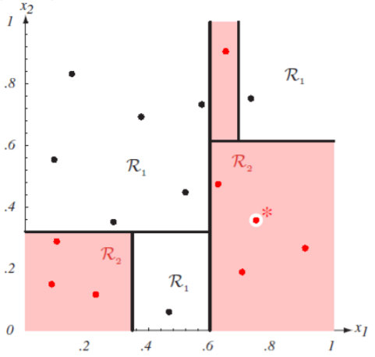
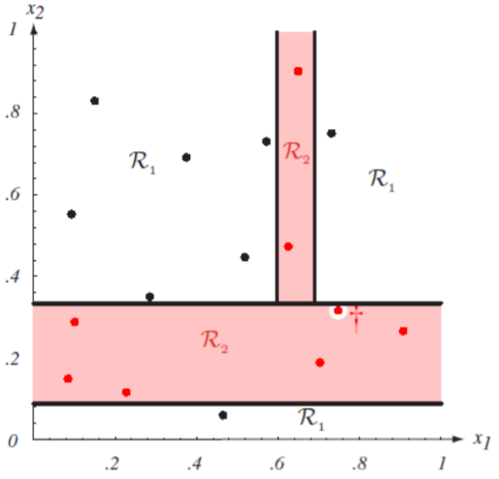
Con’s
Con’s
Unstable. Sensitive to noise
Accuracy may be not good enough (depending on your data)
The optimal splitting is NP. Greedy algorithms are used
Overfitting
Notes:
http://cse.msu.edu/~cse802/DecisionTrees.pdf

Slide 16
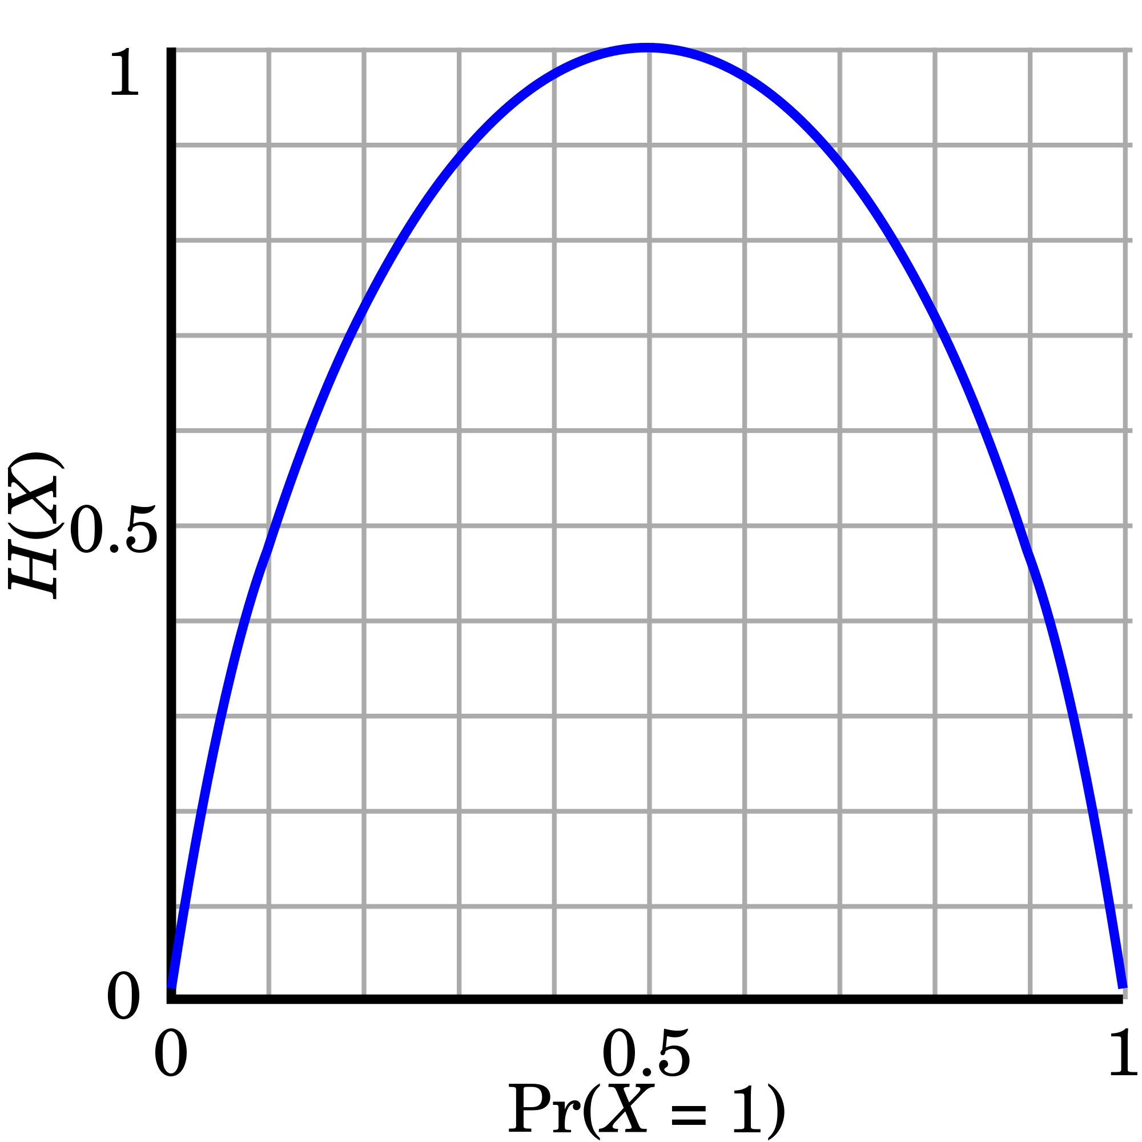
Splitting Measures: Information Gain
Entropy (Information Theory)
A measure of uncertainty associated with a random number
Calculation: For a discrete random variable Y taking m distinct values {y₁, y₂, …, y_{m}}
Interpretation
Higher entropy → higher uncertainty
Lower entropy → lower uncertainty
Conditional entropy
m = 2

Slide 17
Information Gain: An Attribute Selection Measure
Select the attribute with the highest information gain (used in typical decision tree induction algorithm: ID3/C4.5)
Let p_{i} be the probability that an arbitrary tuple in D belongs to class C_{i}, estimated by |C_{i, D}|/|D|
Expected information (entropy) needed to classify a tuple in D:
Information needed (after using A to split D into v partitions) to classify D:
Information gained by branching on attribute A
Notes:
I : the expected information needed to classify a given sample
E (entropy) : expected information based on the partitioning into subsets by A

Slide 18
Example: Attribute Selection with Information Gain
Class P: buys_computer = “yes”
Class N: buys_computer = “no”
age?
<=30
>40
31..40
age | income | student | credit_rating | buys_computer
<=30 | high | no | fair | no
<=30 | high | no | excellent | no
31..40 | high | no | fair | yes
>40 | medium | no | fair | yes
>40 | low | yes | fair | yes
>40 | low | yes | excellent | no
31..40 | low | yes | excellent | yes
<=30 | medium | no | fair | no
<=30 | low | yes | fair | yes
>40 | medium | yes | fair | yes
<=30 | medium | yes | excellent | yes
31..40 | medium | no | excellent | yes
31..40 | high | yes | fair | yes
>40 | medium | no | excellent | no
means “age <=30” has 5 out of 14 samples, with 2 yes’es and 3 no’s. Hence
age | p_{i} | n_{i} | I(p_{i} , n_{i})
<=30 | 2 | 3 | 0.971
31..40 | 4 | 0 | 0
>40 | 3 | 2 | 0.971

Slide 19
Example: Attribute Selection with Information Gain
Class P: buys_computer = “yes”
Class N: buys_computer = “no”
age | income | student | credit_rating | buys_computer
<=30 | high | no | fair | no
<=30 | high | no | excellent | no
31..40 | high | no | fair | yes
>40 | medium | no | fair | yes
>40 | low | yes | fair | yes
>40 | low | yes | excellent | no
31..40 | low | yes | excellent | yes
<=30 | medium | no | fair | no
<=30 | low | yes | fair | yes
>40 | medium | yes | fair | yes
<=30 | medium | yes | excellent | yes
31..40 | medium | no | excellent | yes
31..40 | high | yes | fair | yes
>40 | medium | no | excellent | no
income | p_{i} | n_{i} | I(p_{i} , n_{i})
high | 2 | 2 | ?
medium | 4 | 2 | ?
low | 3 | 1 | ?
student | p_{i} | n_{i} | I(p_{i} , n_{i})
Yes | 6 | 1 | ?
no | 3 | 4 | ?
Similarly, we can get
Credit_rating | p_{i} | n_{i} | I(p_{i} , n_{i})
excellent | ? | ? | ?
fair | ? | ? | ?

Slide 20
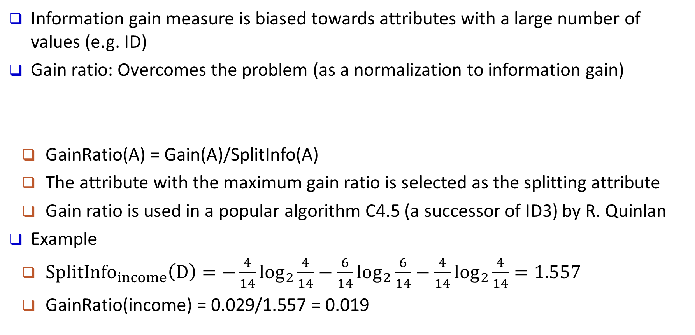
Gain Ratio: A Refined Measure for Attribute Selection
Information gain measure is biased towards attributes with a large number of values (e.g. ID)
Gain ratio: Overcomes the problem (as a normalization to information gain)
GainRatio(A) = Gain(A)/SplitInfo(A)
The attribute with the maximum gain ratio is selected as the splitting attribute
Gain ratio is used in a popular algorithm C4.5 (a successor of ID3) by R. Quinlan
Example
$SplitInfo_{income}\left(D\right)=−\frac{4}{14}\log_{2}\frac{4}{14}−\frac{6}{14}\log_{2}\frac{6}{14}−\frac{4}{14}\log_{2}\frac{4}{14}=1.557$
GainRatio(income) = 0.029/1.557 = 0.019

Slide 21
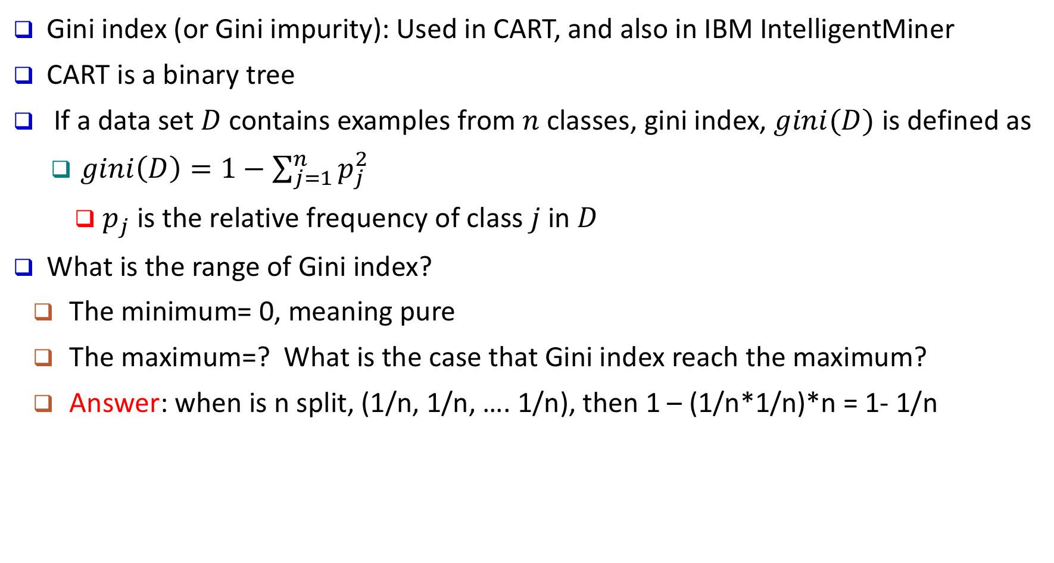
Another Measure: Gini Index
Gini index (or Gini impurity): Used in CART, and also in IBM IntelligentMiner
CART is a binary tree
If a data set $D$ contains examples from $n$ classes, gini index, $gini(D)$ is defined as
$gini\left(D\right)=1−\sum_{j=1}^{n}{p_{j}^{2}}$
$p_{j}$ is the relative frequency of class $j$ in $D$
What is the range of Gini index?
The minimum= 0, meaning pure
The maximum=? What is the case that Gini index reach the maximum?
Answer: when is n split, (1/n, 1/n, …. 1/n), then 1 – (1/n*1/n)*n = 1- 1/n

Slide 22
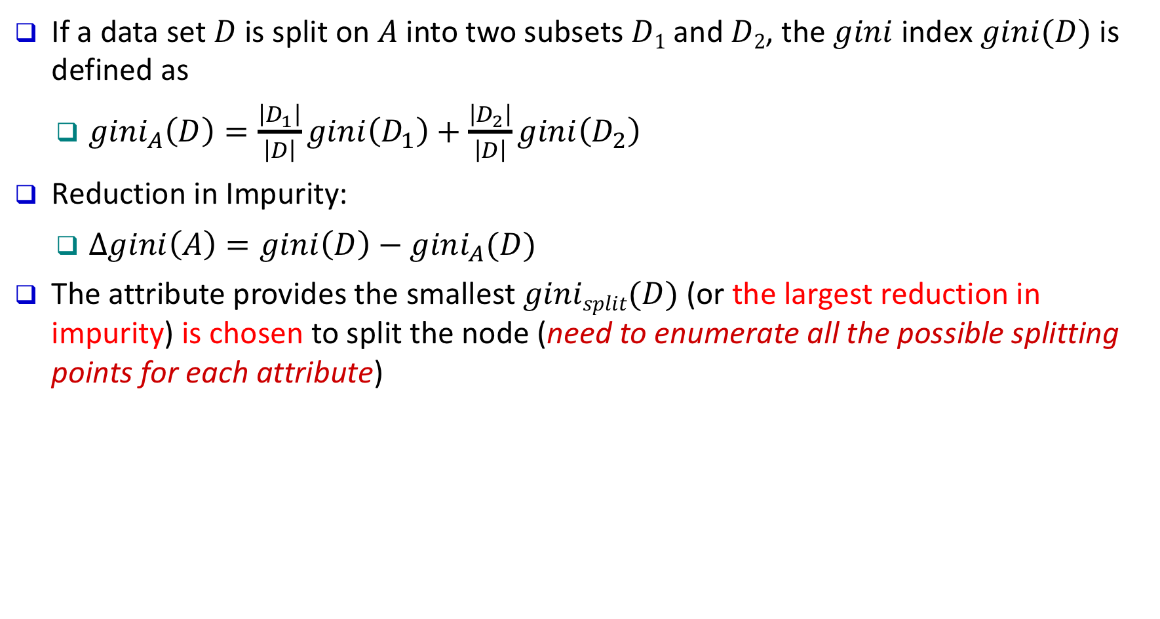
Another Measure: Gini Index
If a data set $D$ is split on $A$ into two subsets $D1$ and $D2$, the $gini$ index $gini(D)$ is defined as
$gini_{A}\left(D\right)=\frac{\left|D_{1}\right|}{\left|D\right|}gini\left(D_{1}\right)+\frac{\left|D_{2}\right|}{\left|D\right|}gini\left(D_{2}\right)$
Reduction in Impurity:
$Δgini\left(A\right)=gini\left(D\right)−gini_{A}(D)$
The attribute provides the smallest $ginisplit(D)$ (or the largest reduction in impurity) is chosen to split the node (need to enumerate all the possible splitting points for each attribute)

Slide 23
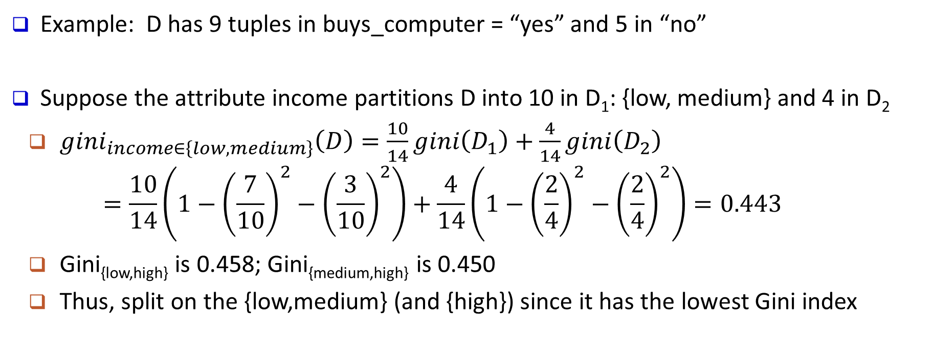
Computation of Gini Index
Example: D has 9 tuples in buys_computer = “yes” and 5 in “no”
Suppose the attribute income partitions D into 10 in D₁: {low, medium} and 4 in D₂
$gini_{income∈\left\{low, medium\right\}}\left(D\right)=\frac{10}{14}gini\left(D_{1}\right)+\frac{4}{14}gini\left(D_{2}\right)$
$$=\frac{10}{14}\left(1−{\left(\frac{7}{10}\right)}^{2}−{\left(\frac{3}{10}\right)}^{2}\right)+\frac{4}{14}\left(1−{\left(\frac{2}{4}\right)}^{2}−{\left(\frac{2}{4}\right)}^{2}\right)=0.443$$
Gini_{{low,high}} is 0.458; Gini_{{medium,high}} is 0.450
Thus, split on the {low,medium} (and {high}) since it has the lowest Gini index

Slide 24
Comparing Three Attribute Selection Measures
The three measures, in general, return good results but
Information gain:
biased towards multivalued attributes
Gain ratio:
tends to prefer unbalanced splits in which one partition is much smaller than the others
Gini index:
biased to multivalued attributes
has difficulty when # of classes is large
tends to favor tests that result in equal-sized partitions and purity in both partitions

Slide 25
Comparing Three Attribute Selection Measures
In reality
Theoretical comparison between the gini index and information gain criteria
It only matters in 2% of the cases.
Entropy might be a little slower to compute (because of the logarithm).

Slide 26
Other Attribute Selection Measures
Minimal Description Length (MDL) principle
Philosophy: The simplest solution is preferred
The best tree as the one that requires the fewest # of bits to both (1) encode the tree, and (2) encode the exceptions to the tree
CHAID: a popular decision tree algorithm, measure based on χ² test for independence
Multivariate splits (partition based on multiple variable combinations)
CART: finds multivariate splits based on a linear combination of attributes
There are many other measures proposed in research and applications
E.g., G-statistics, C-SEP
Which attribute selection measure is the best?
Most give good results, none is significantly superior than others

Slide 27
Overfitting and Tree Pruning
Overfitting: An induced tree may overfit the training data
Too many branches, some may reflect anomalies due to noise or outliers
Poor accuracy for unseen samples

Slide 28
Overfitting and Tree Pruning
Two approaches to avoid overfitting
Use a cross-validation set to compute the errors
Pre-pruning (Early stop): Stop splitting if the cross-validation error does not decrease significantly enough
Efficient but prone to under-fit (stop too early)
Post-pruning: After the full tree is constructed, prune back to the point where the cross-validation error is minimum
Extra computations but mathematically rigorous
Can be used alone, in combination, or not at all
For different purposes (accuracy, efficiency, interpretability)

Slide 29
Classification in Large Databases
Classification—a classical problem extensively studied by statisticians and machine learning researchers
Scalability: Classifying data sets with millions of examples and hundreds of attributes with reasonable speed
Why is decision tree induction popular?
Relatively fast learning speed
Convertible to simple and easy to understand classification rules
Easy to be adapted to database system implementations (e.g., using SQL)
Comparable classification accuracy with other methods
Easy to ensemble, i.e., random forests, xgboost

Slide 30
RainForest: A Scalable Classification Framework
The criteria that determine the quality of the tree can be computed separately
Builds an AVC-list: AVC (Attribute, Value, Class_label)
AVC-set (of an attribute X )
Projection of training dataset onto the attribute X and class label where counts of individual class label are aggregated
AVC-set on Age
AVC-set on Income
AVC-group (of a node n )
Set of AVC-sets of all predictor attributes at the node n
age | income | student | credit_rating | buys
<=30 | high | no | fair | no
<=30 | high | no | excellent | no
31..40 | high | no | fair | yes
>40 | medium | no | fair | yes
>40 | low | yes | fair | yes
>40 | low | yes | excellent | no
31..40 | low | yes | excellent | yes
<=30 | medium | no | fair | no
<=30 | low | yes | fair | yes
>40 | medium | yes | fair | yes
<=30 | medium | yes | excellent | yes
31..40 | medium | no | excellent | yes
31..40 | high | yes | fair | yes
>40 | medium | no | excellent | no
Age | Buy_Computer
 | yes | no
<=30 | 2 | 3
31..40 | 4 | 0
>40 | 3 | 2
income | Buy_Computer
 | yes | no
high | 2 | 2
medium | 4 | 2
low | 3 | 1
AVC-set on Student
AVC-set on Credit_Rating
student | Buy_Computer
 | yes | no
yes | 6 | 1
no | 3 | 4
Credit rating | Buy_Computer
 | yes | no
fair | 6 | 2
excellent | 3 | 3
The Training Data
Its AVC Sets

Slide 31
Visualization of a Decision Tree (in scikit-learn)

Slide 32
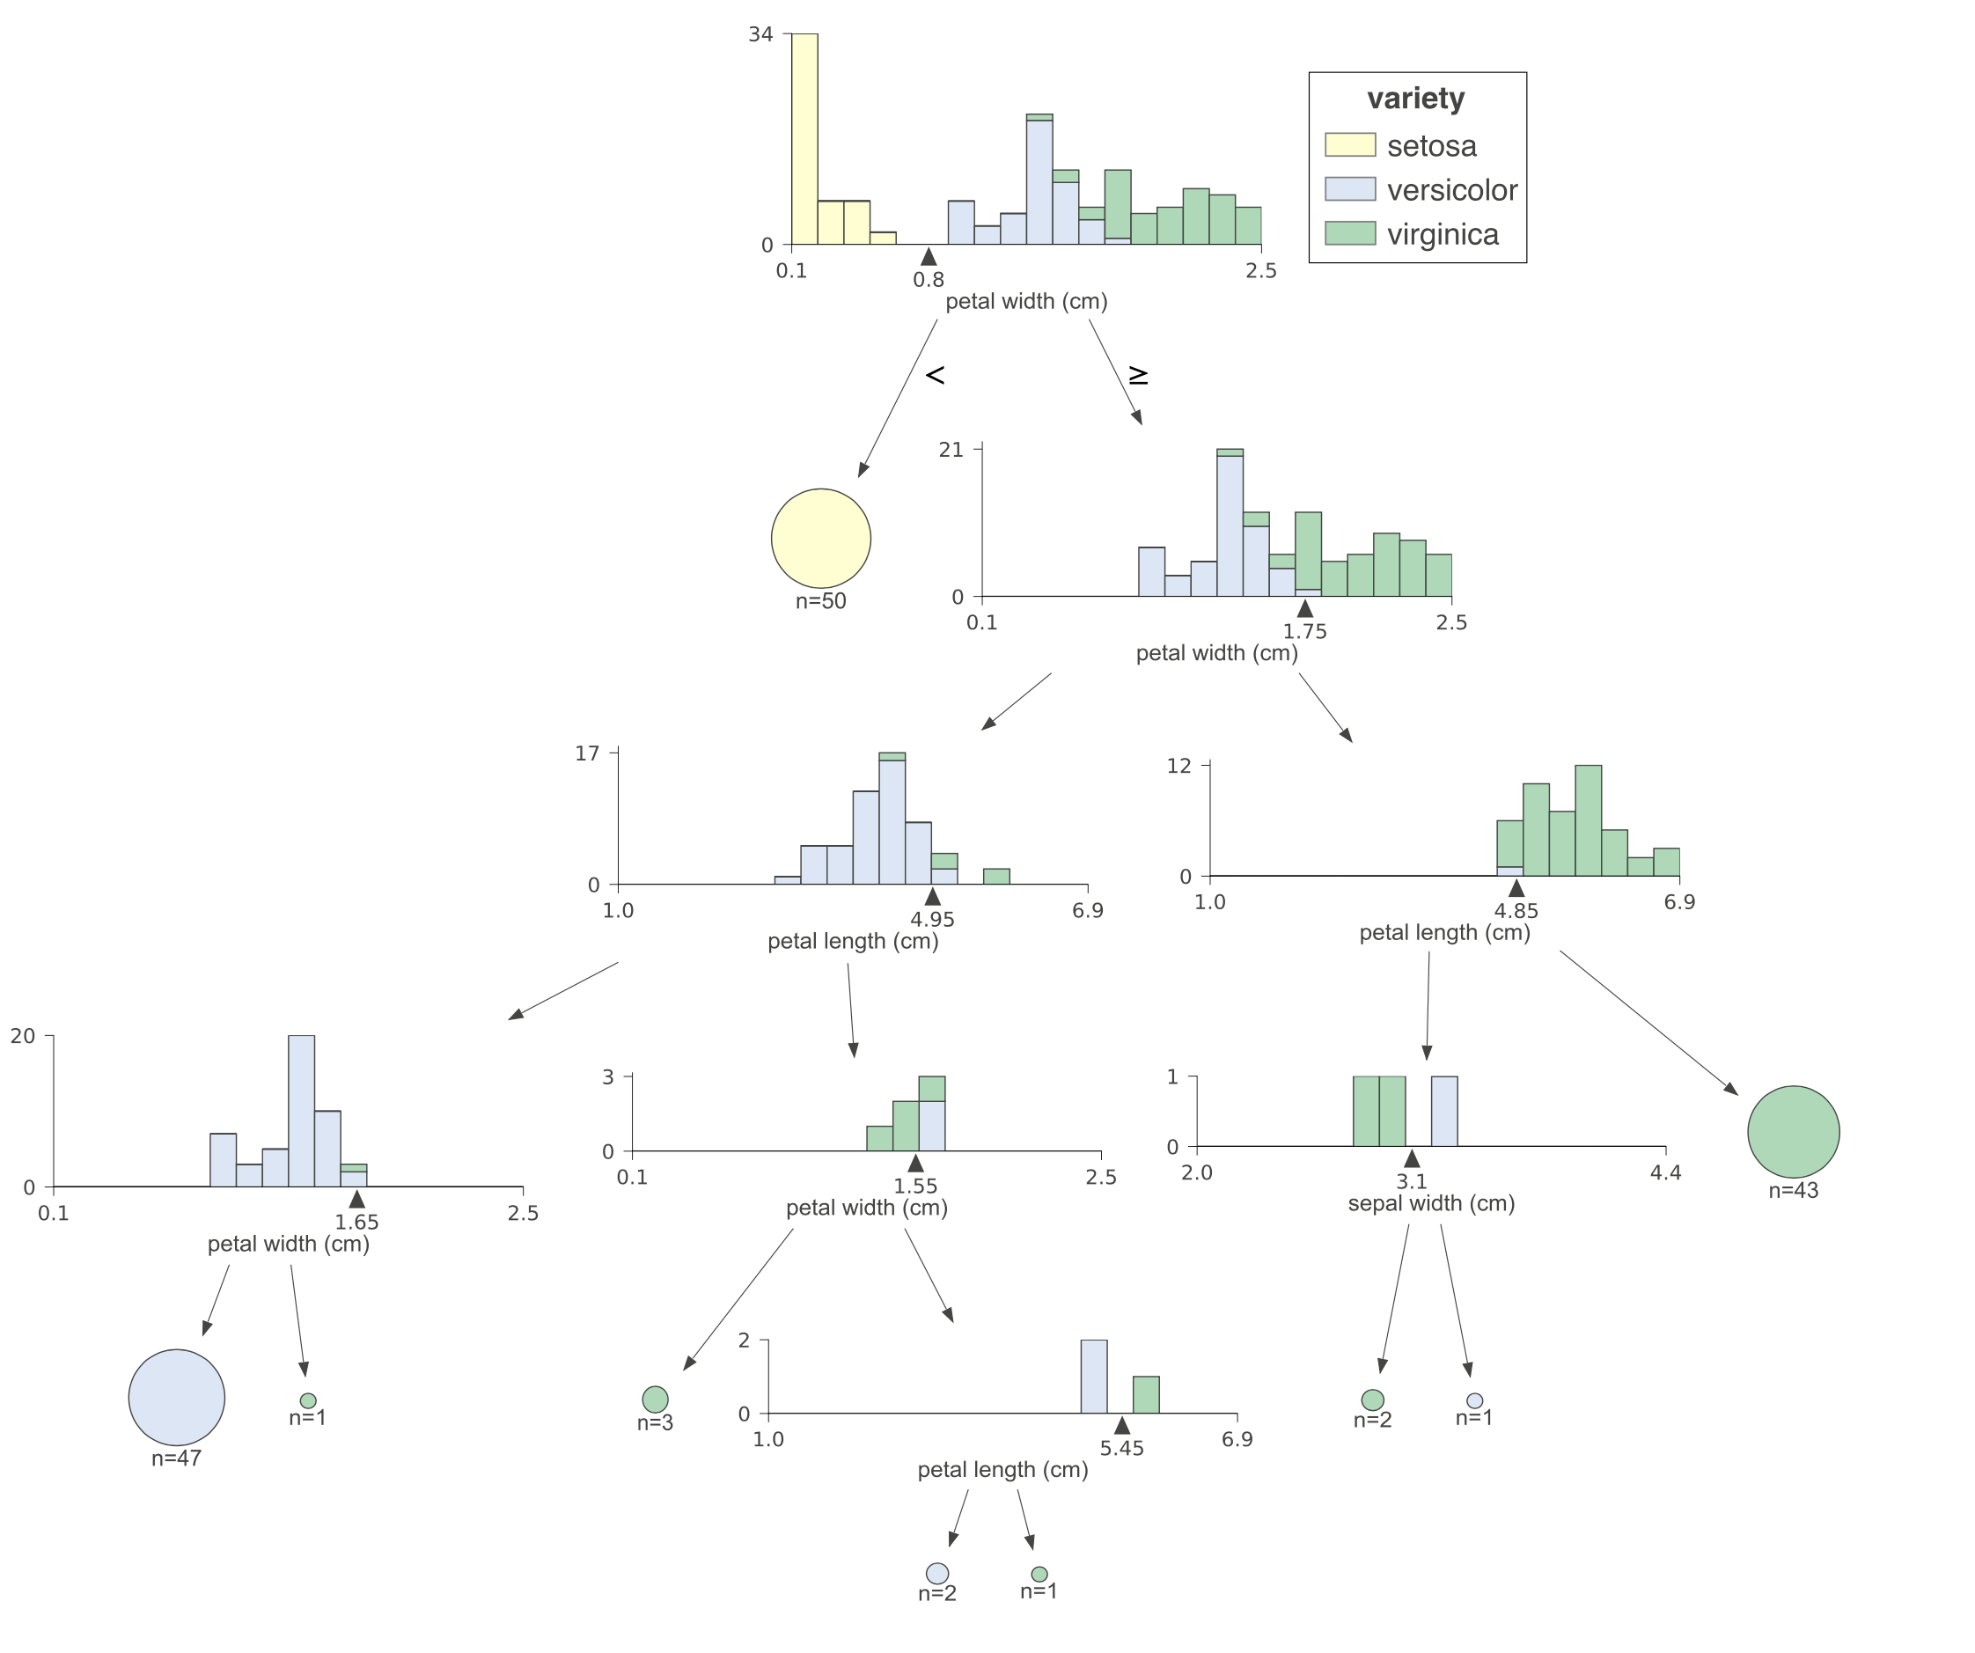
Visualization of a Decision Tree

Slide 33
Chapter 8. Classification: Basic Concepts
Classification: Basic Concepts
Decision Tree Induction
Bayes Classification Methods
Linear Classifier
Model Evaluation and Selection
Imbalanced Data Sets
Additional Concepts on Classification
Summary
Notes:
33

Slide 34
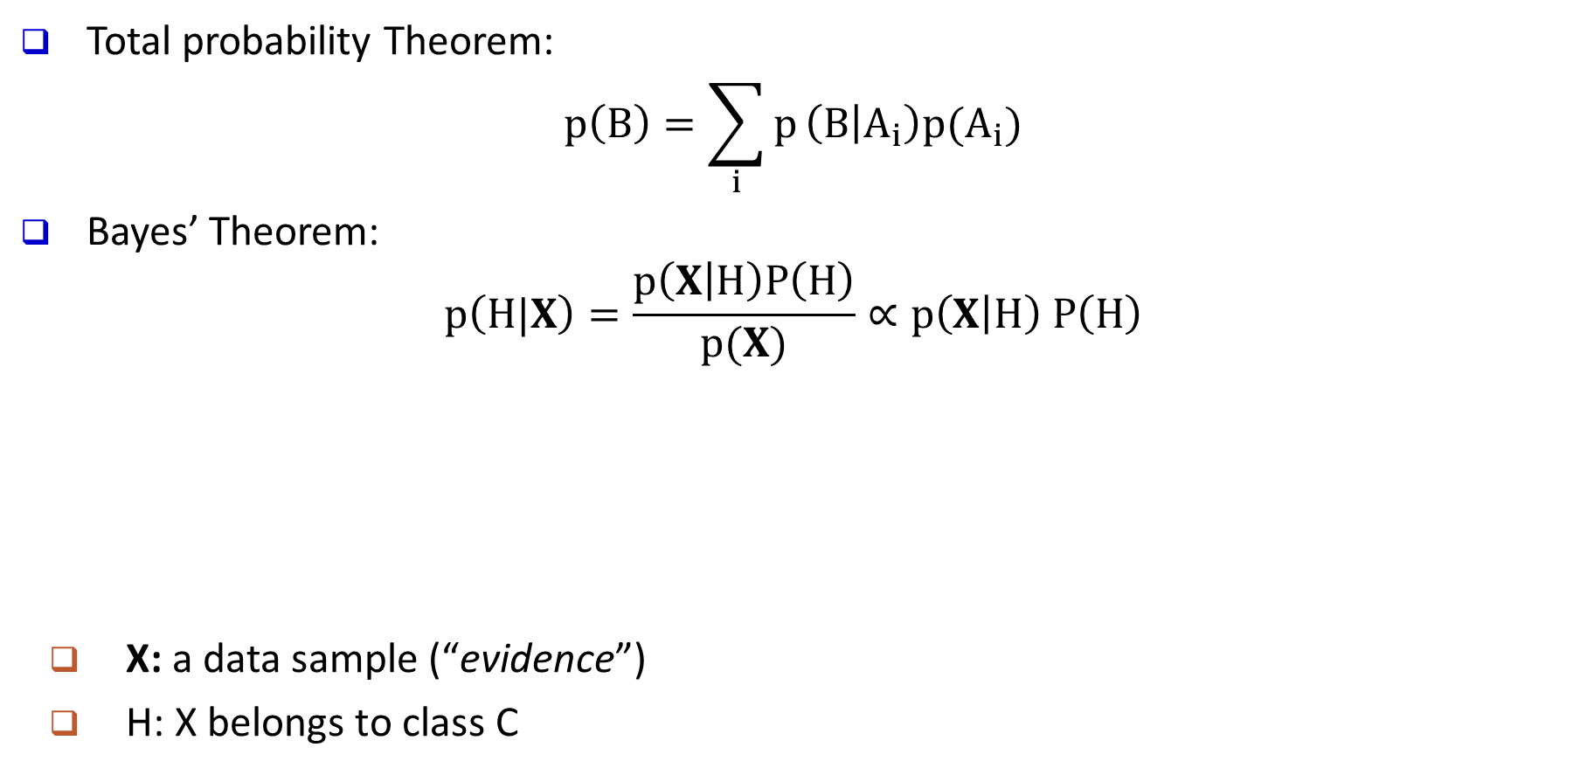
Bayes’ Theorem: Basics
Total probability Theorem:
$$p\left(B\right)=\sum_{i}{p}\left(B | A_{i}\right)p(A_{i})$$
Bayes’ Theorem:
$$p\left(H|X\right)=\frac{p\left(X | H\right)P\left(H\right)}{p(X)}∝p\left(X | H\right) P\left(H\right)$$
X: a data sample (“evidence”)
H: X belongs to class C
posteriori probability
likelihood
prior probability
What we should choose
What we just see
What we knew previously
Prediction can be done based on Bayes’ Theorem:
Classification is to derive the maximum posteriori

Slide 35
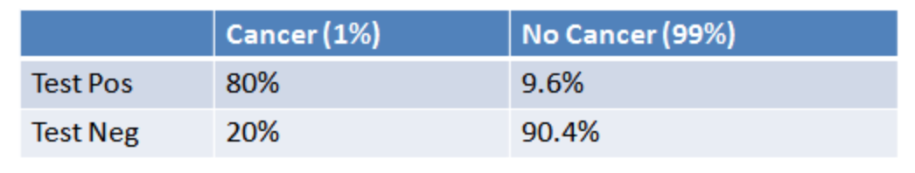
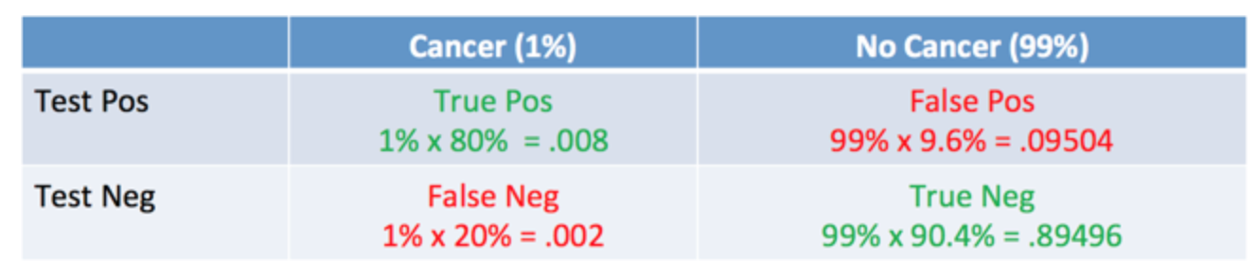
Bayes’ Theorem Example 1: Cancer Tests
Only 1% people have cancer
How accurate is the test?
80%? 99%? 1%?
P(XH) = P(X|H)P(H)
Chance of true positive is thus
1%*80% = 0.008
According to Bayes’ Theorem, P(H|X) = P(X|H)P(H)/P(X), the chance of having a cancer given positive test results is
True pos / (True pos + False pos) = 0.008 / (0.008+0.09504) = 7.76%
The Theorem lets us correct for the skewness introduced by false positives

Slide 36
Bayes’ Theorem Example 2: Picnic Day
The morning is cloudy ☹
What is the chance of rain?
50% of all rainy days start off cloudy.
Cloudy mornings are common (40% of days start cloudy)
This is usually a dry month (only 3 of 30 days tend to be rainy)
P(Rain | Cloud) = ?
P(Cloud | Rain) = 50%
P(Cloud) = 40%
P(Rain) = 10%
P(Rain | Cloud) = P(Rain) P(Cloud | Rain) / P(Cloud) = 10% * 50% / 40% = 12.5%
Again, the chance of rain is probably not as high as expected ☺
Bayes’ Theorem allows us to tell back and forth between posterior and likelihood
(e.g., P(Rain | Cloud) and P(Cloud | Rain)), tests and reality, which is the most important trick in Bayesian Inference

Slide 37
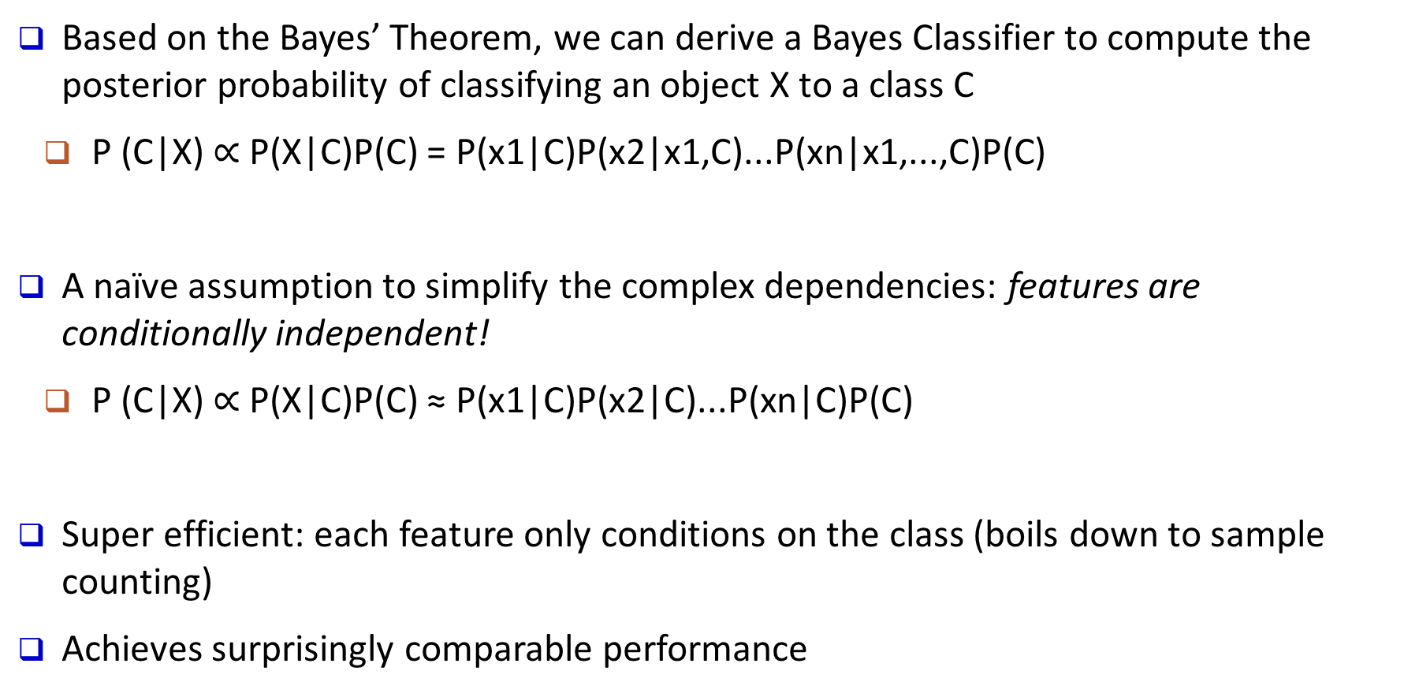
Naïve Bayes Classifier: Making a Naïve Assumption
Based on the Bayes’ Theorem, we can derive a Bayes Classifier to compute the posterior probability of classifying an object X to a class C
P (C|X) $∝$ P(X|C)P(C) = P(x1|C)P(x2|x1,C)...P(xn|x1,...,C)P(C)
A naïve assumption to simplify the complex dependencies: features are conditionally independent!
P (C|X) $∝$ P(X|C)P(C) ≈ P(x1|C)P(x2|C)...P(xn|C)P(C)
Super efficient: each feature only conditions on the class (boils down to sample counting)
Achieves surprisingly comparable performance
Notes:
What is naïve bayes

Slide 38
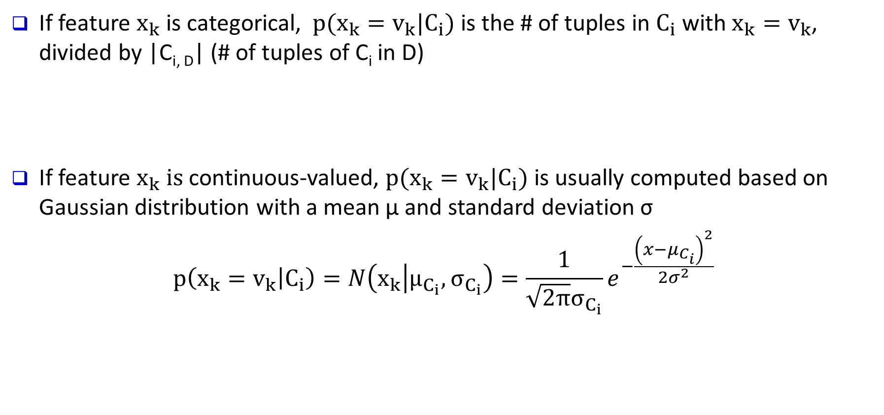
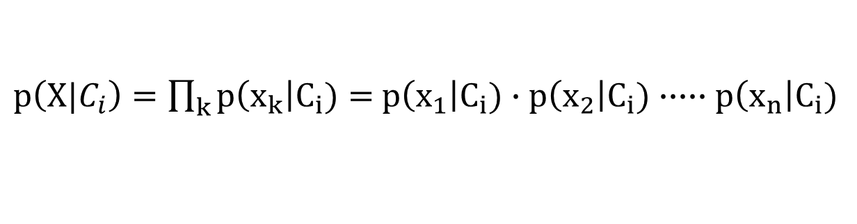
Naïve Bayes Classifier: Categorical vs. Continuous Valued Features
If feature $x_{k}$ is categorical, $p(x_{k}=v_{k}|C_{i})$ is the # of tuples in $C_{i}$ with $x_{k}=v_{k}$, divided by |C_{i, D}| (# of tuples of C_{i} in D)
If feature $x_{k} is$continuous-valued, $p(x_{k}=v_{k}|C_{i})$ is usually computed based on Gaussian distribution with a mean μ and standard deviation σ
$$p\left(x_{k}=v_{k} | C_{i}\right)=N\left(x_{k} | μ_{C_{i}}, σ_{C_{i}}\right)=\frac{1}{\sqrt{2π}σ_{C_{i}}}e^{−\frac{{\left(x−μ_{C_{i}}\right)}^{2}}{2σ^{2}}}$$
$p\left(X|C_{i}\right)=\prod_{k}{p\left(x_{k}\right|C_{i})}=$ $p\left(x_{1}\right|C_{i})∙p\left(x_{2}\right|C_{i})∙∙∙∙∙p\left(x_{n}\right|C_{i})$

Slide 39
Naïve Bayes Classifier: Training Dataset
age | income | student | credit_rating | buys_computer
<=30 | high | no | fair | no
<=30 | high | no | excellent | no
31..40 | high | no | fair | yes
>40 | medium | no | fair | yes
>40 | low | yes | fair | yes
>40 | low | yes | excellent | no
31..40 | low | yes | excellent | yes
<=30 | medium | no | fair | no
<=30 | low | yes | fair | yes
>40 | medium | yes | fair | yes
<=30 | medium | yes | excellent | yes
31..40 | medium | no | excellent | yes
31..40 | high | yes | fair | yes
>40 | medium | no | excellent | no
Class:
C1:buys_computer = ‘yes’
C2:buys_computer = ‘no’
Data to be classified:
X = (age <=30, Income = medium,
Student = yes, Credit_rating = Fair)

Slide 40

Naïve Bayes Classifier: Training Dataset
age | income | student | credit_rating | buys_computer
<=30 | high | no | fair | no
<=30 | high | no | excellent | no
31..40 | high | no | fair | yes
>40 | medium | no | fair | yes
>40 | low | yes | fair | yes
>40 | low | yes | excellent | no
31..40 | low | yes | excellent | yes
<=30 | medium | no | fair | no
<=30 | low | yes | fair | yes
>40 | medium | yes | fair | yes
<=30 | medium | yes | excellent | yes
31..40 | medium | no | excellent | yes
31..40 | high | yes | fair | yes
>40 | medium | no | excellent | no
$$P\left(C_{i} | X\right)∝P\left(X | C_{i}\right)∗P(C_{i})$$
P(C_{i}):
P(buys_computer = “yes”)
P(buys_computer = “no”)
= 9/14 = 0.643
= 5/14= 0.357

Slide 41
Naïve Bayes Classifier: An Example
age | income | student | credit_rating | buys_computer
<=30 | high | no | fair | no
<=30 | high | no | excellent | no
31..40 | high | no | fair | yes
>40 | medium | no | fair | yes
>40 | low | yes | fair | yes
>40 | low | yes | excellent | no
31..40 | low | yes | excellent | yes
<=30 | medium | no | fair | no
<=30 | low | yes | fair | yes
>40 | medium | yes | fair | yes
<=30 | medium | yes | excellent | yes
31..40 | medium | no | excellent | yes
31..40 | high | yes | fair | yes
>40 | medium | no | excellent | no
Compute P(X|C_{i}) for each class:
P(age = “<=30”|buys_computer = “yes”)
P(age = “<= 30”|buys_computer = “no”)
P(income = “medium” | buys_computer = “yes”)
P(income = “medium” | buys_computer = “no”)
P(student = “yes” | buys_computer = “yes)
P(student = “yes” | buys_computer = “no”)
P(credit_rating = “fair” | buys_computer = “yes”)
P(credit_rating = “fair” | buys_computer = “no”)
= 2/9 = 0.222
= 3/5 = 0.6
= 4/9 = 0.444
= 2/5 = 0.4
= 6/9 = 0.667
= 1/5 = 0.2
= 6/9 = 0.667
= 2/5 = 0.4

Slide 42
Naïve Bayes Classifier: An Example
X = (age <= 30 , income = medium, student = yes, credit_rating = fair)
P(X|C_{i}) :
P(X|buys_computer = “yes”) =
P(age = “<=30”|buys_computer = “yes”)
P(income = “medium” | buys_computer = “yes”)
P(student = “yes” | buys_computer = “yes)
P(credit_rating = “fair” | buys_computer = “yes”)
= 0.222 x 0.444 x 0.667 x 0.667 = 0.044
P(X|buys_computer = “no”) =
P(age = “<= 30”|buys_computer = “no”)
P(income = “medium” | buys_computer = “no”)
P(student = “yes” | buys_computer = “no”)
P(credit_rating = “fair” | buys_computer = “no”)
= 0.6 x 0.4 x 0.2 x 0.4 = 0.019
P(X|C_{i}) | C1 = yes | C2 = no
age <= 30 | 0.222 | 0.6
Inc. = med. | 0.444 | 0.4
Stu. = yes | 0.667 | 0.2
Credit = fair | 0.667 | 0.4
Conditional probability
P(X|C_{i})*P(C_{i}) :
P(X|buys_computer = “yes”) * P(buys_computer = “yes”) = 0.028
P(X|buys_computer = “no”) * P(buys_computer = “no”) = 0.007
Therefore, X is classified to class (“buys_computer = yes”)

Slide 43
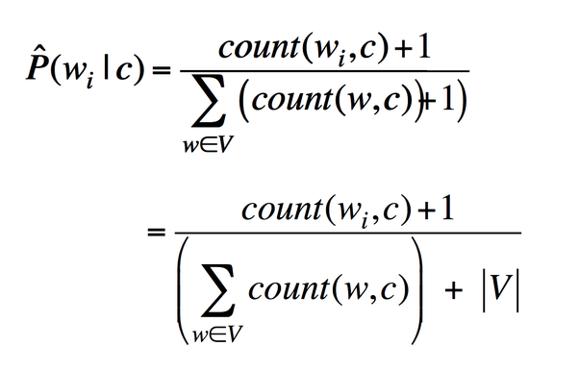
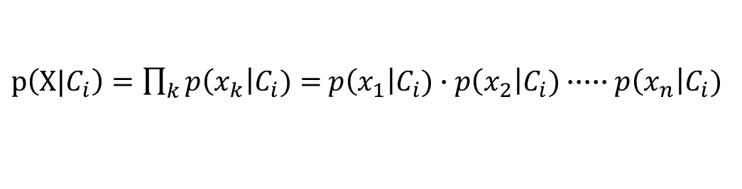
Avoiding the Zero-Probability Problem
Naïve Bayesian prediction requires each conditional probability be non-zero
Otherwise, the predicted probability will be zero
Example. Suppose a dataset with 1000 tuples:
income = low (0), income= medium (990), and income = high (10)
Use Laplacian correction (or Laplacian estimator)
Adding 1 to each case
Prob(income = low) = 1/(1000 + 3)
Prob(income = medium) = (990 + 1)/(1000 + 3)
Prob(income = high) = (10 + 1)/(1000 + 3)
The “corrected” probability estimates are close to their “uncorrected” counterparts
$p\left(X|C_{i}\right)=\prod_{k}{p\left(x_{k}\right|C_{i})}=$ $p\left(x_{1}\right|C_{i})∙p\left(x_{2}\right|C_{i})∙∙∙∙∙p\left(x_{n}\right|C_{i})$

Slide 44
Naïve Bayes Classifier: Strength vs. Weakness
Strength
Performance: A naïve Bayesian classifier, has comparable performance with decision tree and selected neural network classifiers
Incremental: Each training example can incrementally increase/decrease the probability that a hypothesis is correct—prior knowledge can be combined with observed data

Slide 45
Naïve Bayes Classifier: Strength vs. Weakness
Weakness
Assumption: attributes conditional independence, therefore loss of accuracy
E.g., Patient’s Profile: (age, family history),
Patient’s Symptoms: (fever, cough),
Patient’s Disease: (lung cancer, diabetes).
Dependencies among these cannot be modeled by Naïve Bayes Classifier
How to deal with these dependencies?
Use Bayesian Belief Networks (to be covered in the next chapter)

Slide 46
Chapter 8. Classification: Basic Concepts
Classification: Basic Concepts
Decision Tree Induction
Bayes Classification Methods
Linear Classifier
Model Evaluation and Selection
Imbalanced Data Sets
Additional Concepts on Classification
Summary
Notes:
46

Slide 47
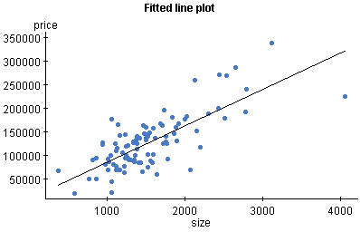
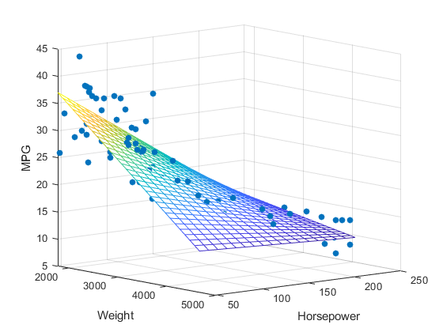
Linear Regression Problem: Example
Mapping from independent attributes to continuous value: x => y
{living area} => Price of the house
{college; major; GPA} => Future Income
Price of houses
Living Area

Slide 48
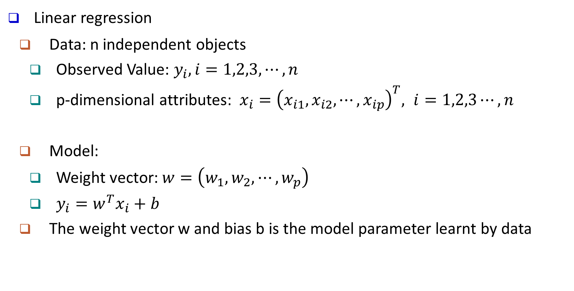
Linear Regression Problem: Model
Linear regression
Data: n independent objects
Observed Value: $y_{i}, i=1,2,3,⋯,n$
p-dimensional attributes: $x_{i}={\left(x_{i1},x_{i2},⋯, x_{ip}\right)}^{T}, i=1,2,3⋯,n$
Model:
Weight vector: $w=\left(w_{1},w_{2},⋯,w_{p}\right)$
$y_{i}=w^{T}x_{i}+b$
The weight vector w and bias b is the model parameter learnt by data

Slide 49
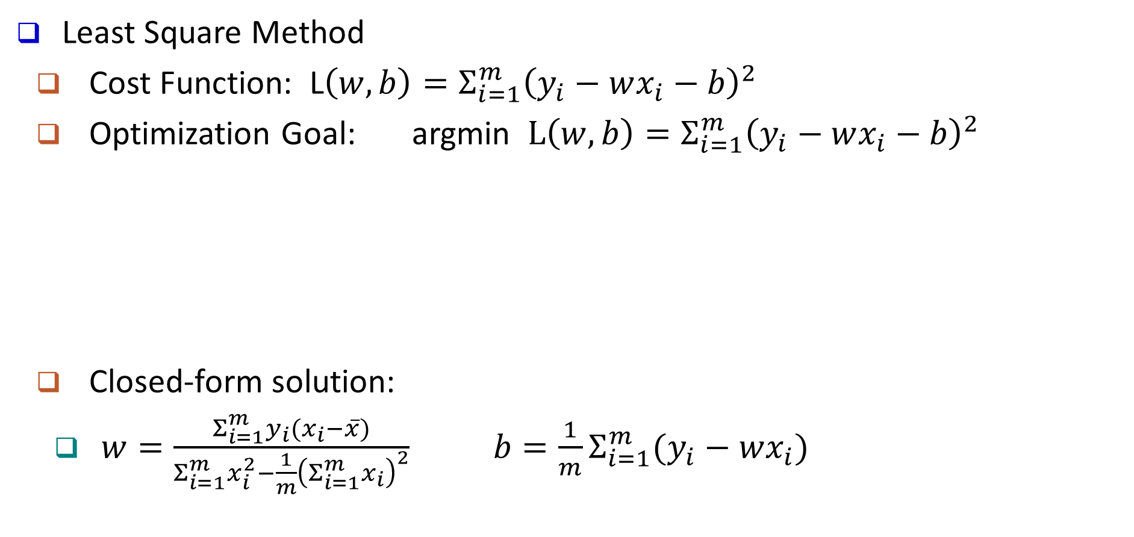
Linear Regression Model: Solution
Least Square Method
Cost Function: L$\left(w,b\right)=Σ_{i=1}^{m}{\left(y_{i}−wx_{i}−b\right)}^{2}$
Optimization Goal: argmin $L\left(w,b\right)=Σ_{i=1}^{m}{\left(y_{i}−wx_{i}−b\right)}^{2}$
Closed-form solution:
$w=\frac{Σ_{i=1}^{m}y_{i}(x_{i}−\overline{x})}{Σ_{i=1}^{m}x_{i}^{2}−\frac{1}{m}{\left(Σ_{i=1}^{m}x_{i}\right)}^{2}} b=\frac{1}{m}Σ_{i=1}^{m}(y_{i}−wx_{i})$
(w,b)
Notes:
Jiaxin: I think we should do the detailed calculation in class???

Slide 50
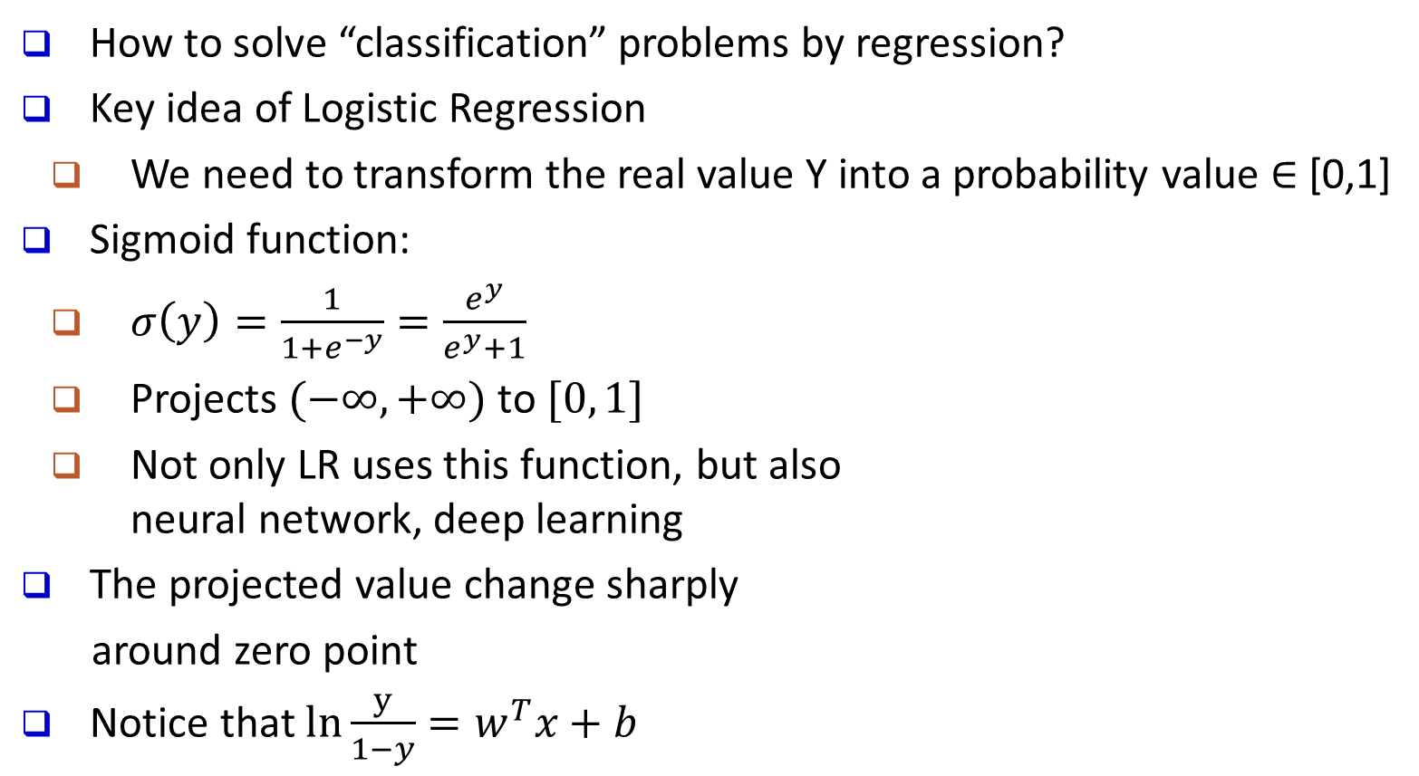
Logistic Regression: General Ideas
How to solve “classification” problems by regression?
Key idea of Logistic Regression
We need to transform the real value Y into a probability value $∈$ [0,1]
Sigmoid function:
$σ\left(y\right)=\frac{1}{1+e^{−y}}=\frac{e^{y}}{e^{y}+1}$
Projects $(−∞, +∞)$ to $[0, 1]$
Not only LR uses this function, but also neural network, deep learning
The projected value change sharply
around zero point
Notice that $ln\frac{y}{1−y}=w^{T}x+b$
Sigmoid
Function

Slide 51
Logistic Regression: An Example
Suppose we only consider the year as feature
1 (Tenured)
year
6

Slide 52
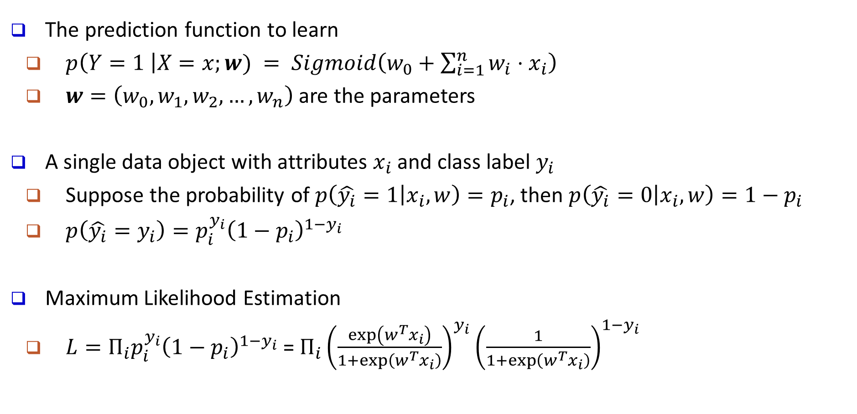
Logistic Regression: Model
The prediction function to learn
$p\left(Y=1 \right|X=x;w) = Sigmoid\left(w_{0}+\sum_{i=1}^{n}{w_{i}⋅x_{i}}\right)$
$w=\left(w_{0}, w_{1}, w_{2},…,w_{n}\right)$ are the parameters
A single data object with attributes $x_{i}$ and class label $y_{i}$
Suppose the probability of $p\left(\hat{y_{i}}=1 | x_{i},w\right)=p_{i}$, then $p\left(\hat{y_{i}}=0 | x_{i},w\right)=1−p_{i}$
$p\left(\hat{y_{i}}=y_{i}\right)=p_{i}^{y_{i}}{\left(1−p_{i}\right)}^{1−y_{i}}$
Maximum Likelihood Estimation
$L=Π_{i}p_{i}^{y_{i}}{\left(1−p_{i}\right)}^{1−y_{i}}$ = $Π_{i}{\left(\frac{\exp\left(w^{T}x_{i}\right)}{1+\exp\left(w^{T}x_{i}\right)}\right)}^{y_{i}}{\left(\frac{1}{1+\exp\left(w^{T}x_{i}\right)}\right)}^{1−y_{i}}$

Slide 53
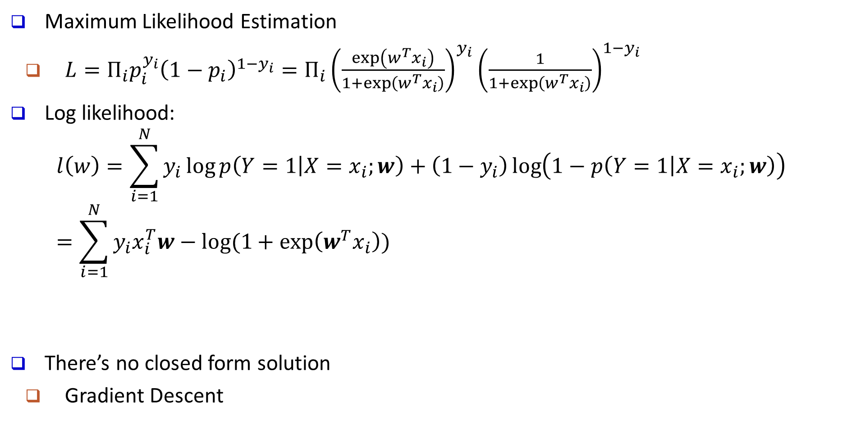
Logistic Regression: Optimization
Maximum Likelihood Estimation
$L=Π_{i}p_{i}^{y_{i}}{\left(1−p_{i}\right)}^{1−y_{i}}=Π_{i}{\left(\frac{\exp\left(w^{T}x_{i}\right)}{1+\exp\left(w^{T}x_{i}\right)}\right)}^{y_{i}}{\left(\frac{1}{1+\exp\left(w^{T}x_{i}\right)}\right)}^{1−y_{i}}$
Log likelihood:
$$l\left(w\right)=\sum_{i=1}^{N}{y_{i}}\log{p\left(Y=1 | X=x_{i};w\right)}+\left(1−y_{i}\right)\log\left(1−p\left(Y=1 | X=x_{i};w\right)\right)=\sum_{i=1}^{N}{y_{i}x_{i}^{T}w−log⁡(1+exp\left(w^{T}x_{i}\right))}$$
There’s no closed form solution
Gradient Descent

Slide 54
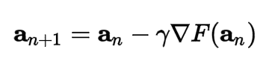
Gradient Descent
Gradient Descent is an iterative optimization algorithm for finding the minimum of a function (e.g., the negative log likelihood)
For a function F(x) at a point a, F(x) decreases fastest if we go in the direction of the negative gradient of a
Step size
When the gradient is zero, we arrive at the local minimum

Slide 55
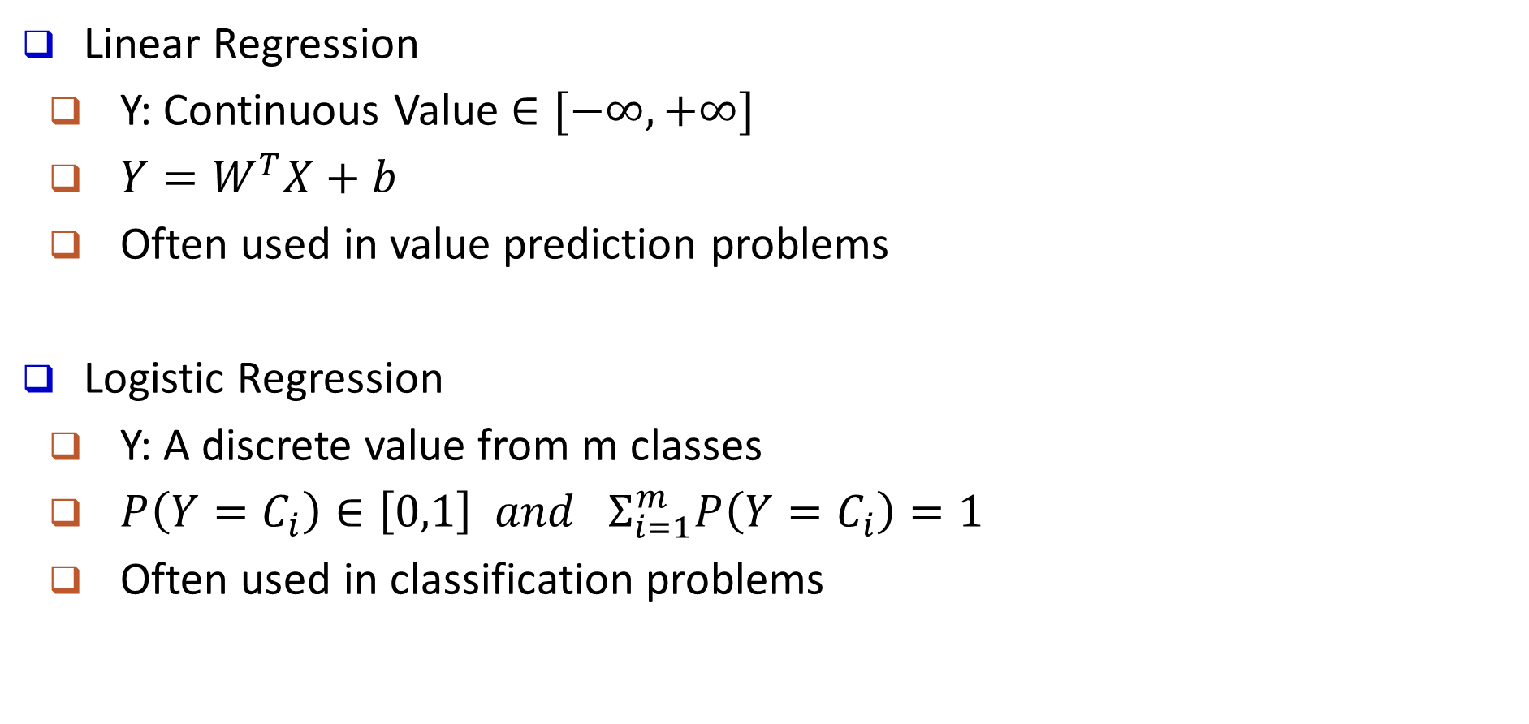
Linear Regression VS. Logistic Regression
Linear Regression
Y: Continuous Value $∈[−∞, +∞]$
$Y=W^{T}X+b$
Often used in value prediction problems
Logistic Regression
Y: A discrete value from m classes
$P\left(Y=C_{i}\right)∈\left[0,1\right] and Σ_{i=1}^{m}P\left(Y=C_{i}\right)=1$
Often used in classification problems

Slide 56
Comments on Logistic Regression
Pros
Can handle multiple types of features
Fast and easy
Generally speaking, more robust and better performance than tree
Interpretable: both weights and predicted value
Predicted value: probability
Weights: effect of the feature. Unit change of log odds
Cons
Linear model: if the decision boundary is not linear, then LR is not good

Slide 57
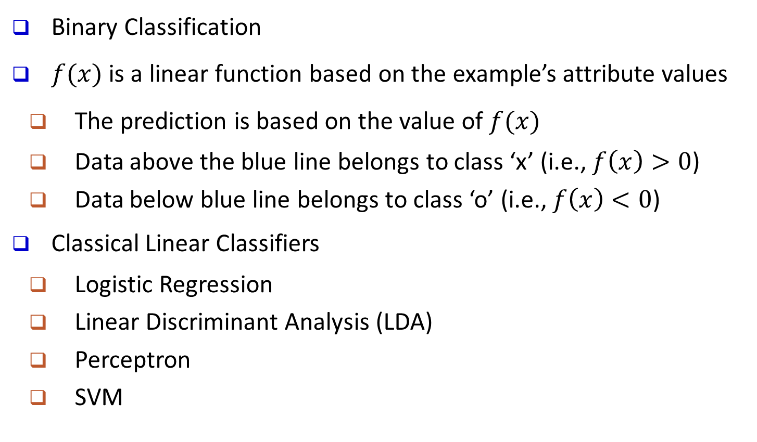
Linear Classifier: General Ideas
Binary Classification
$f(x)$ is a linear function based on the example’s attribute values
The prediction is based on the value of $f(x)$
Data above the blue line belongs to class ‘x’ (i.e., $f\left(x\right)>0$)
Data below blue line belongs to class ‘o’ (i.e., $f\left(x\right)<0$)
Classical Linear Classifiers
Logistic Regression
Linear Discriminant Analysis (LDA)
Perceptron
SVM
x
x
x
x
x
x
x
x
x
o
o
x
o
o
o
o
o
o
o
o
o
o
o

Slide 58
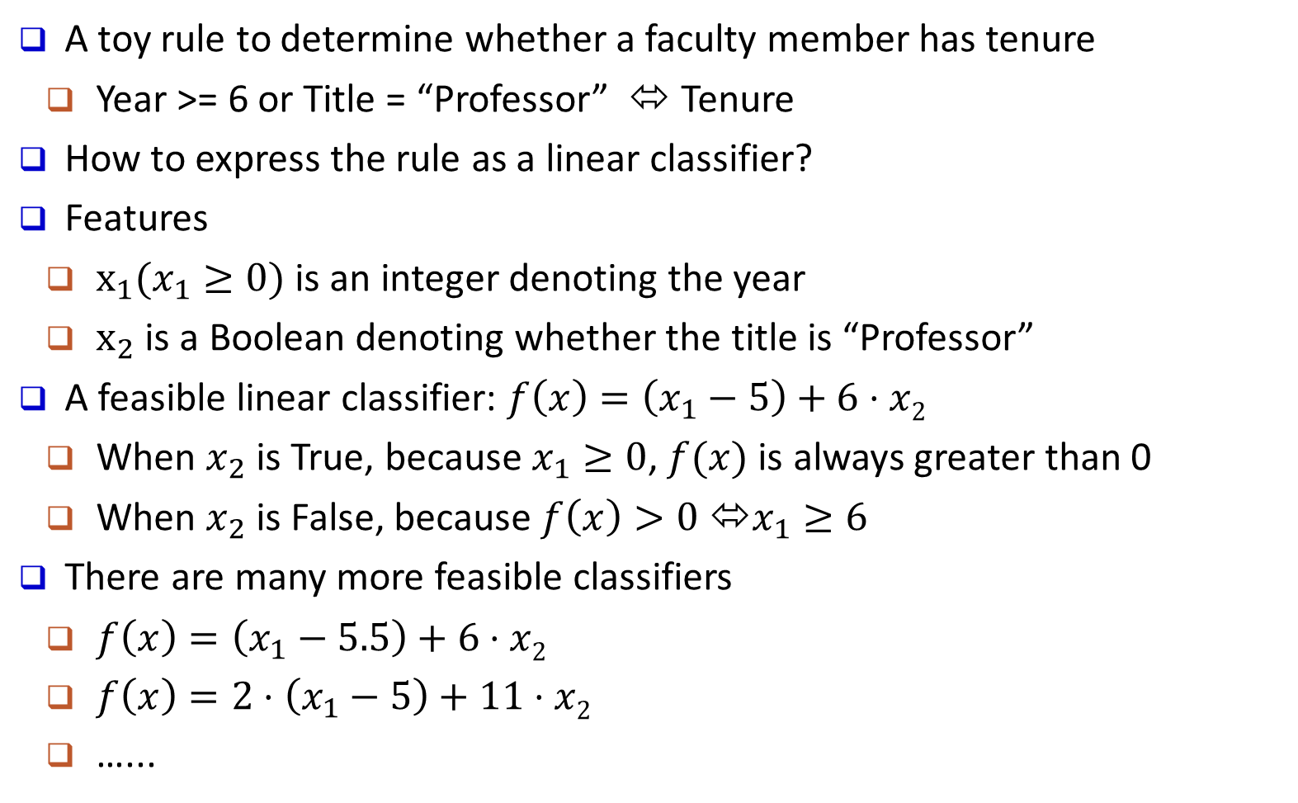
Linear Classifier: An Example
A toy rule to determine whether a faculty member has tenure
Year >= 6 or Title = “Professor” ⬄ Tenure
How to express the rule as a linear classifier?
Features
$x_{1}(x_{1}≥0)$ is an integer denoting the year
$x_{2}$ is a Boolean denoting whether the title is “Professor”
A feasible linear classifier: $f\left(x\right)=\left(x_{1}−5\right)+6⋅x2$
When $x_{2}$ is True, because $x_{1}≥0$, $f(x)$ is always greater than 0
When $x_{2}$ is False, because $f\left(x\right)>0$ ⬄$x_{1}≥6$
There are many more feasible classifiers
$f\left(x\right)=\left(x_{1}−5.5\right)+6⋅x2$
$f\left(x\right)=2⋅\left(x_{1}−5\right)+11⋅x2$
…...

Slide 59
Key Question: Which Line Is Better?
There might be many feasible linear functions
Both H1 and H2 will work
Which one is better?
H2 looks “better” in the sense that it is also furthest from both groups
We will introduce more in the SVM section

Slide 60
Generative vs. Discriminative Classifiers
X: observed variables (features)
Y: target variables (class labels)
A generative classifier models p(Y, X)
It models how the data was "generated"? "what is the likelihood this or that class generated this instance?" and pick the one with higher probability
Naïve Bayes
Bayesian Networks
A discriminative classifier models p(Y|X)
It uses the data to create a decision boundary
Logistic Regression
Support Vector Machines

Slide 61
Further Comments on Discriminative Classifiers
Strength
Prediction accuracy is generally high
As compared to generative models
Robust, works when training examples contain errors
Fast evaluation of the learned target function
Comparing to (covered in future) Bayesian networks (which are normally slow)
Criticism
Long training time
Difficult to understand the learned function (weights)
Bayesian networks can be used easily for pattern discovery
Not easy to incorporate domain knowledge
Easy in the form of priors on the data or distributions
Notes:
61

Slide 62
Chapter 8. Classification: Basic Concepts
Classification: Basic Concepts
Decision Tree Induction
Bayes Classification Methods
Linear Classifier
Model Evaluation and Selection
Imbalanced Data Sets
Additional Concepts on Classification
Summary
Notes:
62

Slide 63
Model Evaluation and Selection
Evaluation metrics
How can we measure accuracy?
Other metrics to consider?
Use validation test set of class-labeled tuples instead of training set when assessing accuracy
Methods for estimating a classifier’s accuracy
Holdout method
Cross-validation
Bootstrap
Comparing classifiers:
ROC Curves

Slide 64
Classifier Evaluation Metrics: Confusion Matrix
Confusion Matrix:
In a confusion matrix w. m classes, CM_{i,j} indicates # of tuples in class i that were labeled by the classifier as class j
May have extra rows/columns to provide totals
Example of Confusion Matrix:
Actual class\Predicted class | C₁ | ¬ C₁
C₁ | True Positives (TP) | False Negatives (FN)
¬ C₁ | False Positives (FP) | True Negatives (TN)
Actual class\Predicted class | buy_computer = yes | buy_computer = no | Total
buy_computer = yes | 6954 | 46 | 7000
buy_computer = no | 412 | 2588 | 3000
Total | 7366 | 2634 | 10000

Slide 65
Classifier Evaluation Metrics: Accuracy, Error Rate, Sensitivity and Specificity
A\P | C | ¬C
C | TP | FN | P
¬C | FP | TN | N
 | P’ | N’ | All
Class imbalance problem
One class may be rare
E.g., fraud, or HIV-positive
Significant majority of the negative class and minority of the positive class
Measures handle the class imbalance problem
Sensitivity (recall): True positive recognition rate
Sensitivity = TP/P
Specificity: True negative recognition rate
Specificity = TN/N
Classifier accuracy, or recognition rate
Percentage of test set tuples that are correctly classified
Accuracy = (TP + TN)/All
Error rate: 1 – accuracy, or
Error rate = (FP + FN)/All

Slide 66
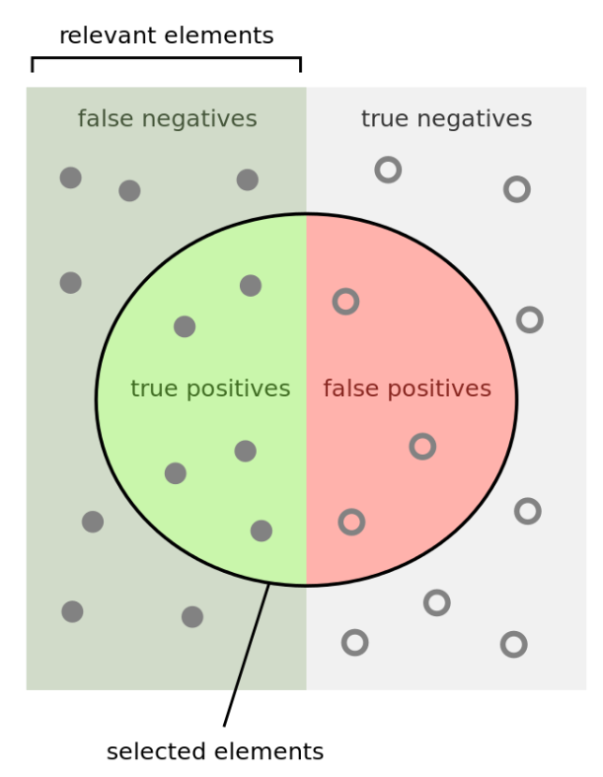
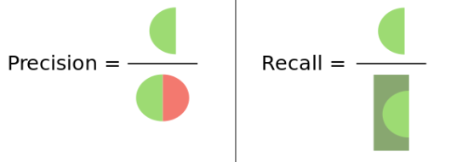
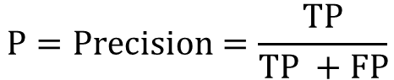
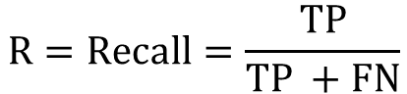
Classifier Evaluation Metrics: Precision and Recall, and F-measures
A\P | C | ¬C
C | TP | FN | P
¬C | FP | TN | N
 | P’ | N’ | All
Precision: Exactness: what % of tuples that the classifier labeled as positive are actually positive?
Recall: Completeness: what % of positive tuples did the classifier label as positive?
Range: [0, 1]
$$P=Precision=\frac{TP}{TP +FP}$$
$$R=Recall=\frac{TP}{TP +FN}$$
https://en.wikipedia.org/wiki/Precision_and_recall

Slide 67
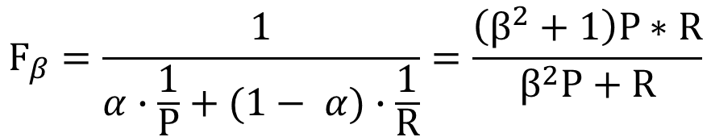
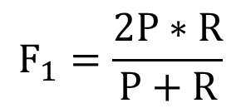
Classifier Evaluation Metrics: Precision and Recall, and F-measures
The “inverse” relationship between precision & recall
We want one number to say if a classifier is good or not
F measure (or F-score): harmonic mean of precision and recall
In general, it is the weighted measure of precision & recall
F1-measure (balanced F-measure)
That is, when β = 1,
$$F_{β}=\frac{1}{α∙\frac{1}{P}+(1− α)∙\frac{1}{R}}=\frac{\left(β^{2}+1\right)P∗R}{β^{2}P+R}$$
Assigning β times as much weight to recall as to precision)
$$F_{1}=\frac{2P∗R}{P+R}$$

Slide 68
Classifier Evaluation Metrics: Example
Use the same confusion matrix, calculate the measure just introduced
Sensitivity =
Specificity =
Accuracy =
Error rate =
Precision =
Recall =
F1 =
Actual Class\Predicted class | cancer = yes | cancer = no | Total
cancer = yes | 90 | 210 | 300
cancer = no | 140 | 9560 | 9700
Total | 230 | 9770 | 10000
Notes:
Sensitivity = TP/P = 90/300 = 30%
Specificity = TN/N = 9560/9700 = 98.56%
Accuracy = (TP + TN)/All = (90+9560)/10000 = 96.50%
Error rate = (FP + FN)/All = (140 + 210)/10000 = 3.50%
Precision = TP/(TP + FP) = 90/(90 + 140) = 90/230 = 39.13%
Recall = TP/ (TP + FN) = 90/(90 + 210) = 90/300 = 30.00%
F1 = 2 P × R /(P + R) = 2 × 39.13% × 30.00%/(39.13% + 30%) = 33.96%

Slide 69
Classifier Evaluation Metrics: Example
Use the same confusion matrix, calculate the measure just introduced
Sensitivity = TP/P = 90/300 = 30%
Specificity = TN/N = 9560/9700 = 98.56%
Accuracy = (TP + TN)/All = (90+9560)/10000 = 96.50%
Error rate = (FP + FN)/All = (140 + 210)/10000 = 3.50%
Precision = TP/(TP + FP) = 90/(90 + 140) = 90/230 = 39.13%
Recall = TP/ (TP + FN) = 90/(90 + 210) = 90/300 = 30.00%
F1 = 2 P × R /(P + R) = 2 × 39.13% × 30.00%/(39.13% + 30%) = 33.96%
Actual Class\Predicted class | cancer = yes | cancer = no | Total
cancer = yes | 90 | 210 | 300
cancer = no | 140 | 9560 | 9700
Total | 230 | 9770 | 10000
Notes:
Sensitivity = TP/P = 90/300 = 30%
Specificity = TN/N = 9560/9700 = 98.56%
Accuracy = (TP + TN)/All = (90+9560)/10000 = 96.50%
Error rate = (FP + FN)/All = (140 + 210)/10000 = 3.50%
Precision = TP/(TP + FP) = 90/(90 + 140) = 90/230 = 39.13%
Recall = TP/ (TP + FN) = 90/(90 + 210) = 90/300 = 30.00%
F1 = 2 P × R /(P + R) = 2 × 39.13% × 30.00%/(39.13% + 30%) = 33.96%

Slide 70
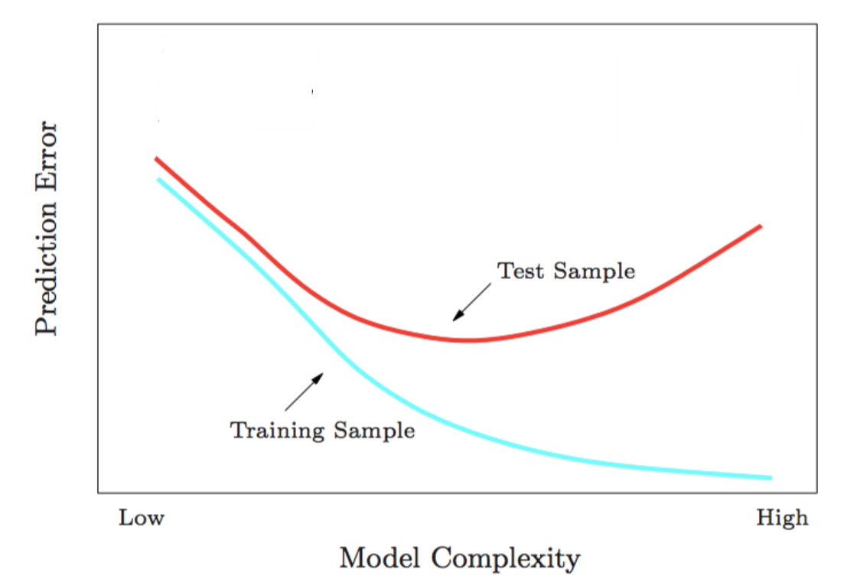
Training Error VS Testing Error
underfitting
overfitting

Slide 71
Classifier Evaluation: Holdout & Cross-Validation
Holdout method
Given data is randomly partitioned into two independent sets
Training set (e.g., 2/3) for model construction
Test set (e.g., 1/3) for accuracy estimation
Repeated random sub-sampling validation: a variation of holdout
Repeat holdout k times, accuracy = avg. of the accuracies obtained
Cross-validation (k-fold, where k = 10 is most popular)
Randomly partition the data into k mutually exclusive subsets, each approximately equal size
At i-th iteration, use D_{i} as test set and others as training set
Leave-one-out: k folds where k = # of tuples, for small sized data
*Stratified cross-validation*: folds are stratified so that class distribution, in each fold is approximately the same as that in the initial data

Slide 72
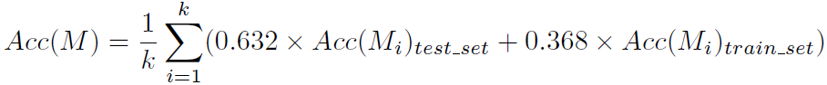
Classifier Evaluation: Bootstrap
Bootstrap
Works well with small data sets
Samples the given training tuples uniformly with replacement
Each time a tuple is selected, it is equally likely to be selected again and re-added to the training set
Several bootstrap methods, and a common one is .632 bootstrap
A data set with d tuples is sampled d times, with replacement, resulting in a training set of d samples. The data tuples that did not make it into the training set end up forming the test set. About 63.2% of the original data end up in the bootstrap, and the remaining 36.8% form the test set (since (1 – 1/d)^{d} ≈ e⁻¹ = 0.368)
Repeat the sampling procedure k times, overall accuracy of the model:

Slide 73
Model Selection: ROC Curves
ROC (Receiver Operating Characteristics) curves: for visual comparison of classification models
Originated from signal detection theory
Shows the trade-off between the true positive rate and the false positive rate
The area under the ROC curve (AUC: Area Under Curve) is a measure of the accuracy of the model
Rank the test tuples in decreasing order: the one that is most likely to belong to the positive class appears at the top of the list
The closer to the diagonal line (i.e., the closer the area is to 0.5), the less accurate is the model
Vertical axis represents the true positive rate (TP/P)
Horizontal axis rep. the false positive rate (FP/N)
The plot also shows a diagonal line
A model with perfect accuracy will have an area of 1.0

Slide 74
Issues Affecting Model Selection
Accuracy
classifier accuracy: predicting class label
Speed
time to construct the model (training time)
time to use the model (classification/prediction time)
Robustness: handling noise and missing values
Scalability: efficiency in disk-resident databases
Interpretability
understanding and insight provided by the model
Other measures, e.g., goodness of rules, such as decision tree size or compactness of classification rules
Notes:
74

Slide 75
Chapter 8. Classification: Basic Concepts
Classification: Basic Concepts
Decision Tree Induction
Bayes Classification Methods
Linear Classifier
Model Evaluation and Selection
Imbalanced Data Sets
Additional Concepts on Classification
Summary
Notes:
75

Slide 76
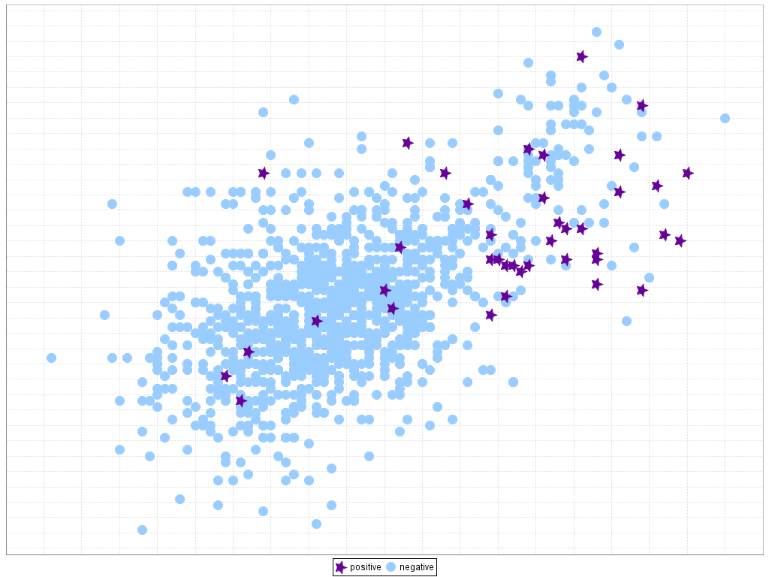
Classification of Class-Imbalanced Data Sets
Traditional methods assume a balanced distribution of classes and equal error costs. But in real world situations, we may face imbalanced data sets, which has rare positive examples but numerous negative ones.
Medical diagnosis: Medical screening for a condition
is usually performed on a large population of people
without the condition, to detect a small minority
with it (e.g., HIV prevalence in the USA is ~0.4%)
Fraud detection: About 2% of credit card accounts
are defrauded per year. (Most fraud detection domains are heavily imbalanced.)
Product defect, accident (oil-spill), disk drive failures, etc.

Slide 77
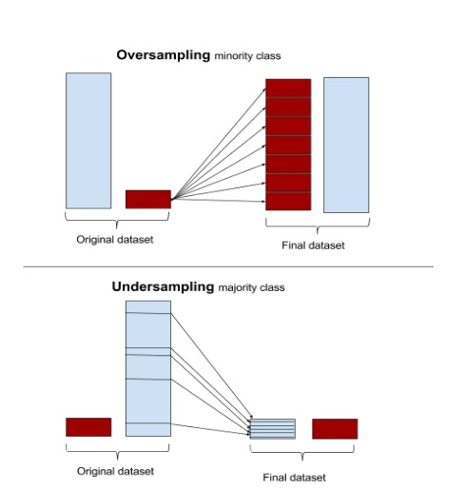
Classification of Class-Imbalanced Data Sets
Typical methods on imbalanced data (Balance the training set)
Oversampling: Oversample the minority class.
Under-sampling: Randomly eliminate tuples from majority class
Synthesizing: Synthesize new minority classes

Slide 78
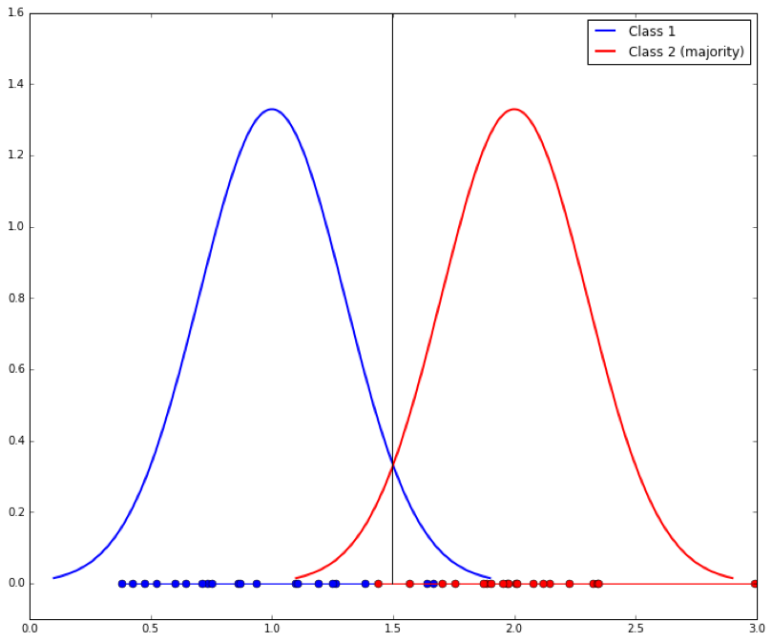
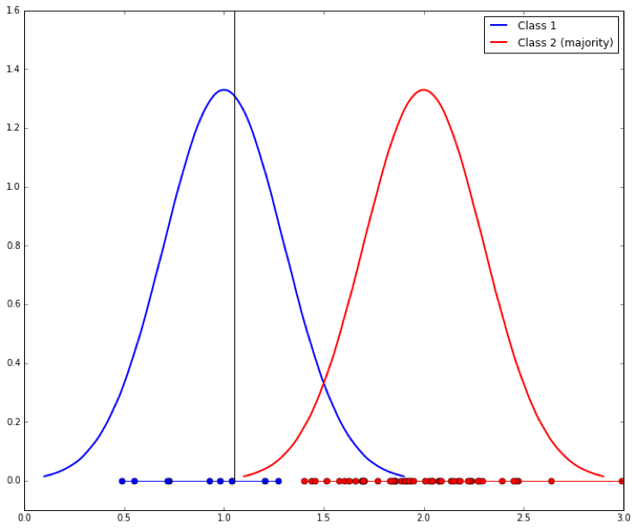
Classification of Class-Imbalanced Data Sets
Typical methods on imbalanced data (At the algorithm level)
Threshold-moving: Move the decision threshold, t, so that the rare class tuples are easier to classify, and hence, less chance of costly false negative errors
Class weight adjusting: Since false negative costs more than false positive, we can give larger weight to false negative
Ensemble techniques: Ensemble multiple classifiers introduced in the following chapter
Threshold-moving

Slide 79
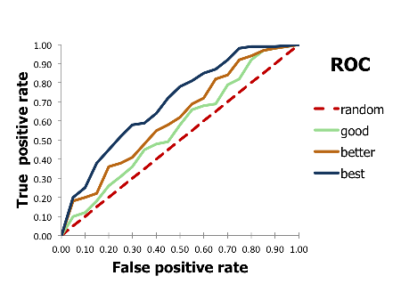
Evaluate imbalanced data classifier
Can we use Accuracy to evaluate imbalanced data classifier?
Accuracy simply counts the number of errors. If a data set has 2% positive labels and 98% negative labels, a classifier that map all inputs to negative class will get an accuracy of 98%!
ROC Curve

Slide 80
Chapter 8. Classification: Basic Concepts
Classification: Basic Concepts
Decision Tree Induction
Bayes Classification Methods
Linear Classifier
Model Evaluation and Selection
Imbalanced Data Sets
Additional Concepts on Classification
Summary
Notes:
80

Slide 81
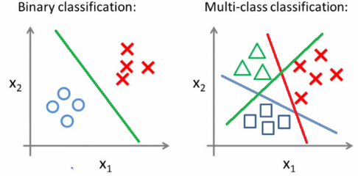
Multiclass Classification
Classification involving more than two classes (i.e., > 2 Classes)
Methodology: Reducing the multi-class problem into multiple binary problems
Method 1. One-vs.-rest (or one-vs.-all)
Given m classes, train m classifiers: one for each class
Classifier j: treat tuples in class j as positive & all the rest as negative
To classify a tuple X, the set of classifiers vote as an ensemble

Slide 82
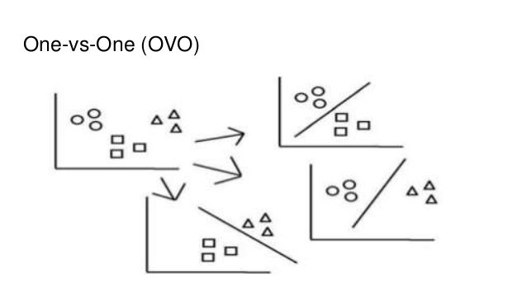
Multiclass Classification
Method 2. one-vs.-one (or all-vs.-all): Learn a classifier for each pair of classes
Given m classes, construct m(m − 1)/2 binary classifiers
A classifier is trained using tuples of the two classes
To classify a tuple X, each classifier votes
X is assigned to the class with maximal vote
Comparison: One-vs.-one tends to perform better than one-vs.-rest
Many new algorithms have been developed to go beyond binary classifier method

Slide 83
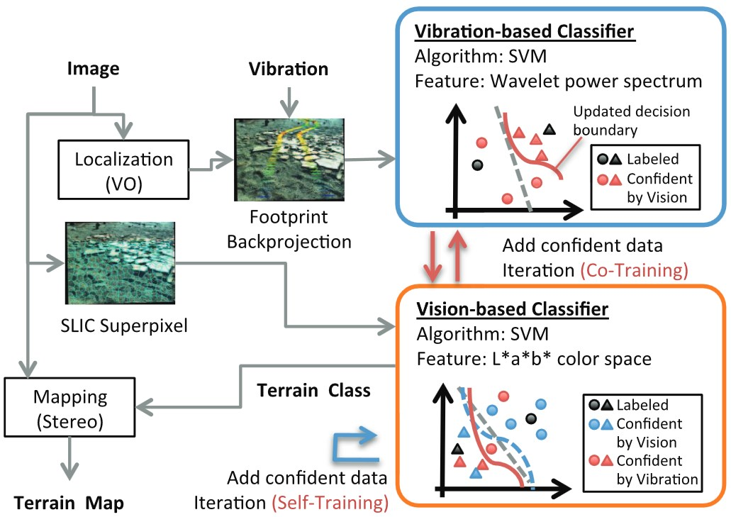
Semi-Supervised Classification
Semi-supervised: Uses labeled and unlabeled data to build a classifier
Self-training
1. Build a classifier using the labeled data
2. Use it to label the unlabeled data, and those with the most confident label prediction are added to the set of labeled data
3. Repeat the step 1 and 2
Adv.: easy to understand; Disadv.: may reinforce errors
Labeled
Confident by classifier1

Slide 84
Semi-Supervised Classification
Semi-supervised: Uses labeled and unlabeled data to build a classifier
Co-training: Use two or more classifiers to teach each other
Each learner uses a mutually independent set of features of each tuple to train a good classifier, say f₁ and f₂
Then f₁ and f₂ are used to predict the class label for unlabeled data X
Teach each other: The tuple having the most confident prediction from f₁ is added to the set of labeled data for f₂ & vice versa
Other methods include joint probability distribution of features and labels
Labeled
Confident by classifier1
Confident by classifier2

Slide 85
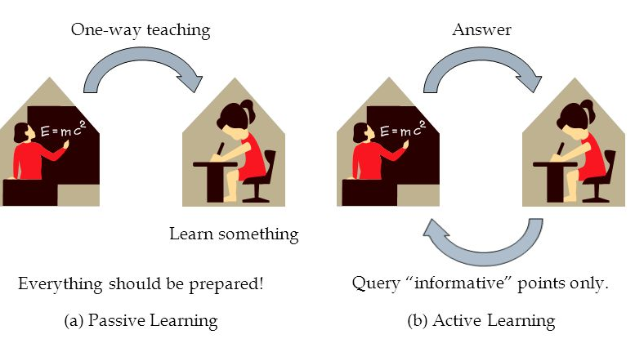
Active Learning
A special case of semi-supervised learning
Active learner: Interactively query teachers (oracle) for labels of “informative” data

Slide 86
Active Learning
Pool-based approach: Uses a pool of unlabeled data
L: a small subset of D is labeled, U: a pool of unlabeled data in D
Use a query function to carefully select one or more tuples from U and request labels from an oracle (a human annotator)
The newly labeled samples are added to L, and learn a model
Goal: Achieve high accuracy using as few labeled data as possible
One good choice: unlabeled point closest to the current decision boundary

Slide 87
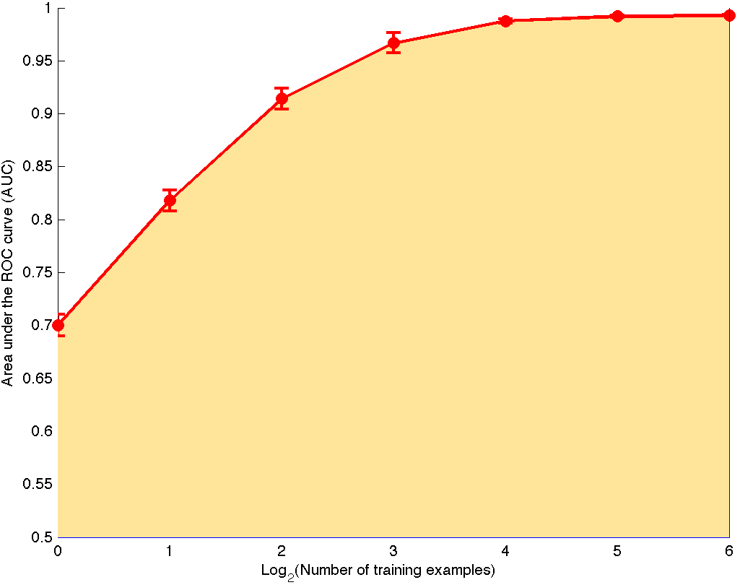
Active Learning
Evaluated using learning curves: Accuracy as a function of the number of instances queried (# of tuples to be queried should be small)

Slide 88
Transfer Learning: Conceptual Framework
Traditional learning: Build a new classifier for each new task
Transfer learning: Extract knowledge from one or more source tasks (e.g., recognizing cars) and apply the knowledge to a target task (e.g., recognizing trucks)
Many algorithms are developed, applied to text classification, spam filtering, etc.
Traditional Learning Framework
Transfer Learning Framework

Slide 89
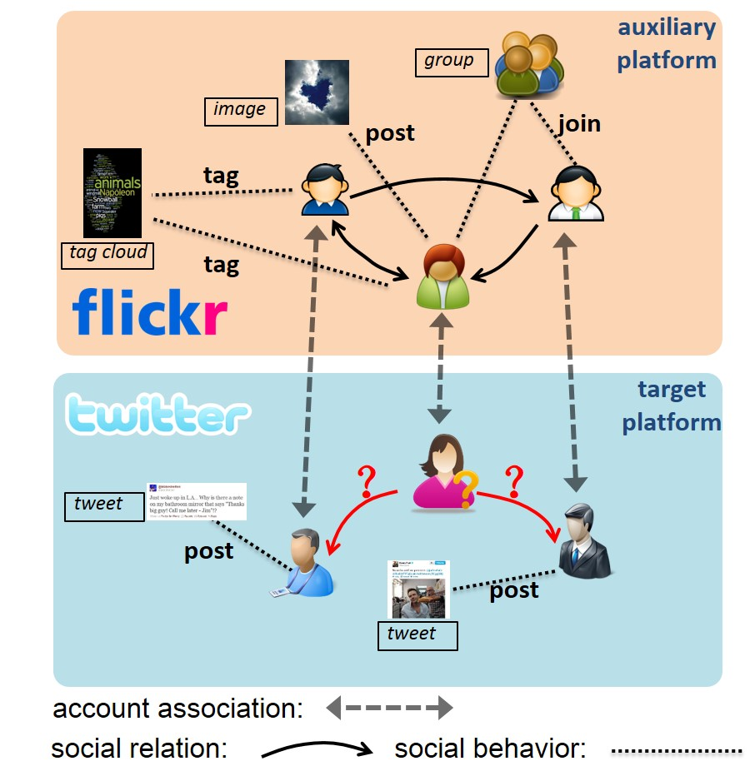
Transfer Learning: An Example
Cross-platform friend recommendation[1]
Users’ social relation and behavior in one platform(flickr) offers important knowledge about social interest in another platform(Twitter)
[1]http://nlpr-web.ia.ac.cn/mmc/homepage/myan/Project_YanMing/ming_ICME2013/material/ICME2013Final.pdf

Slide 90
Weak Supervision: A New Programming Paradigm for Machine Learning
Overcome the training data bottleneck
Leverage higher-level and/or noisier input from experts
Sources of cheaply and efficiently provided weak labels
Higher-level, less precise supervision (e.g., heuristic rules, expected label distributions)
Cheaper, lower-quality supervision (e.g. crowdsourcing)
Existing resources (e.g. knowledge bases, pre-trained models)

Slide 91
Weak Supervision: A New Programming Paradigm for Machine Learning
These weak label distributions could take many forms
Weak Labels from crowd workers, output of heuristic rules, knowledge base(e.g. wikipedia), or the output of other classifiers, etc.
Constraints and invariances (e.g., from physics, logic, or other experts)
Probability distributions (e.g., from weak or biased classifiers or user-provided label or feature expectations or measurements)

Slide 92
Weak Supervision: A New Programming Paradigm for Machine Learning
These weak label distributions could suffer from noises or errors
Insufficient labeling
Labeled Data + Unlabeled Data
Non-Unique labeling
Multi-label data: Label multiple valid labels to each data tuple
Ambiguous labeling
Partial-label data: Label multiple candidate labels to each data tuple

Slide 93
Relationships Among Different Kinds of Supervisions
Courtesy: A Ratner et al. @Stanford Blog, July 2017

Slide 94
Chapter 8. Classification: Basic Concepts
Classification: Basic Concepts
Decision Tree Induction
Bayes Classification Methods
Linear Classifier
Model Evaluation and Selection
Imbalanced Data Sets
Additional Concepts on Classification
Summary
Notes:
94

Slide 95
Summary
Classification: Model construction from a set of training data
Effective and scalable methods
Decision tree induction, Bayes classification methods, linear classifier, …
No single method has been found to be superior over all others for all data sets
Evaluation metrics: Accuracy, sensitivity, specificity, precision, recall, F measure
Model evaluation: Holdout, cross-validation, bootstrapping, ROC curves (AUC)
Improve Classification Accuracy: Bagging, boosting
Additional concepts on classification: Multiclass classification, semi-supervised classification, active learning, transfer learning, weak supervision

Slide 96
Prepare for Exam
Do calculations Step by step
Decision tree, Naive Bayes classification methods
Accuracy, sensitivity, specificity, precision, recall, F measure
Prediction for logistic regression (with provided parameters)
Concepts
What does a term mean
Describe the procedure
Pros and cons for the classification methods
Interpret the results

Slide 97
References (1)
C. Apte and S. Weiss. Data mining with decision trees and decision rules. Future Generation Computer Systems, 13, 1997
P. K. Chan and S. J. Stolfo. Learning arbiter and combiner trees from partitioned data for scaling machine learning. KDD'95
A. J. Dobson. An Introduction to Generalized Linear Models. Chapman & Hall, 1990.
R. O. Duda, P. E. Hart, and D. G. Stork. Pattern Classification, 2ed. John Wiley, 2001
U. M. Fayyad. Branching on attribute values in decision tree generation. AAAI’94.
Y. Freund and R. E. Schapire. A decision-theoretic generalization of on-line learning and an application to boosting. J. Computer and System Sciences, 1997.
J. Gehrke, R. Ramakrishnan, and V. Ganti. Rainforest: A framework for fast decision tree construction of large datasets. VLDB’98.
J. Gehrke, V. Gant, R. Ramakrishnan, and W.-Y. Loh, BOAT -- Optimistic Decision Tree Construction. SIGMOD'99.
T. Hastie, R. Tibshirani, and J. Friedman. The Elements of Statistical Learning: Data Mining, Inference, and Prediction. Springer-Verlag, 2001.

Slide 98
References (2)
T.-S. Lim, W.-Y. Loh, and Y.-S. Shih. A comparison of prediction accuracy, complexity, and training time of thirty-three old and new classification algorithms. Machine Learning, 2000
J. Magidson. The Chaid approach to segmentation modeling: Chi-squared automatic interaction detection. In R. P. Bagozzi, editor, Advanced Methods of Marketing Research, Blackwell Business, 1994
M. Mehta, R. Agrawal, and J. Rissanen. SLIQ : A fast scalable classifier for data mining. EDBT'96
T. M. Mitchell. Machine Learning. McGraw Hill, 1997
S. K. Murthy, Automatic Construction of Decision Trees from Data: A Multi-Disciplinary Survey, Data Mining and Knowledge Discovery 2(4): 345-389, 1998
J. R. Quinlan. Induction of decision trees. Machine Learning, 1:81-106, 1986.
J. R. Quinlan. C4.5: Programs for Machine Learning. Morgan Kaufmann, 1993.
J. R. Quinlan. Bagging, boosting, and c4.5. AAAI'96.

Slide 99
References (3)
R. Rastogi and K. Shim. Public: A decision tree classifier that integrates building and pruning. VLDB’98
J. Shafer, R. Agrawal, and M. Mehta. SPRINT : A scalable parallel classifier for data mining. VLDB’96
J. W. Shavlik and T. G. Dietterich. Readings in Machine Learning. Morgan Kaufmann, 1990
P. Tan, M. Steinbach, and V. Kumar. Introduction to Data Mining. Addison Wesley, 2005
S. M. Weiss and C. A. Kulikowski. Computer Systems that Learn: Classification and Prediction Methods from Statistics, Neural Nets, Machine Learning, and Expert Systems. Morgan Kaufman, 1991
S. M. Weiss and N. Indurkhya. Predictive Data Mining. Morgan Kaufmann, 1997
I. H. Witten and E. Frank. Data Mining: Practical Machine Learning Tools and Techniques, 2ed. Morgan Kaufmann, 2005

Slide 100


Slide 101
Bayes’ Theorem: Basics
Total probability Theorem:
Bayes’ Theorem:
Let X be a data sample (“evidence”): class label is unknown
Let H be a hypothesis that X belongs to class C
Classification is to determine P(H|X), (i.e., posteriori probability): the probability that the hypothesis holds given the observed data sample X
P(H) (prior probability): the initial probability
E.g., X will buy computer, regardless of age, income, …
P(X): probability that sample data is observed
P(X|H) (likelihood): the probability of observing the sample X, given that the hypothesis holds
E.g., Given that X will buy computer, the prob. that X is 31..40, medium income

Slide 102
Classification Is to Derive the Maximum Posteriori
Let D be a training set of tuples and their associated class labels, and each tuple is represented by an n-D attribute vector X = (x₁, x₂, …, x_{n})
Suppose there are m classes C₁, C₂, …, C_{m}.
Classification is to derive the maximum posteriori, i.e., the maximal P(C_{i}|X)
This can be derived from Bayes’ theorem
Since P(X) is constant for all classes, only
needs to be maximized

Slide 103
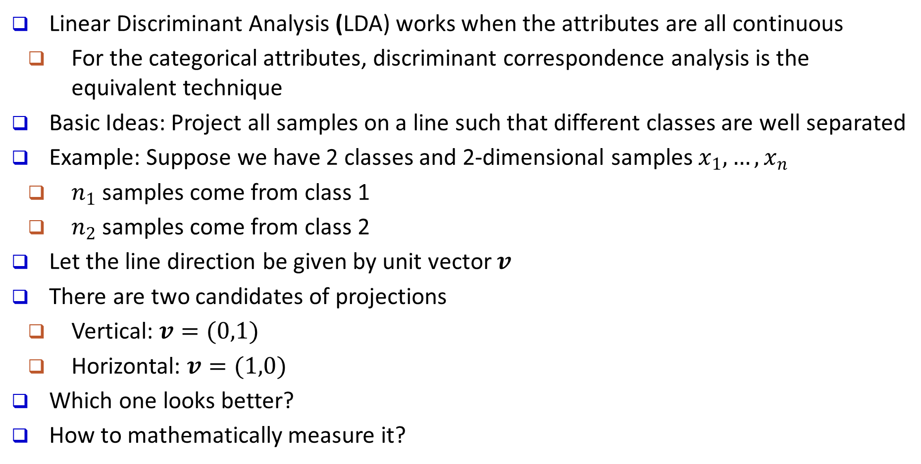
Linear Discriminant Analysis (LDA)
Linear Discriminant Analysis (LDA) works when the attributes are all continuous
For the categorical attributes, discriminant correspondence analysis is the equivalent technique
Basic Ideas: Project all samples on a line such that different classes are well separated
Example: Suppose we have 2 classes and 2-dimensional samples $x_{1},…,x_{n}$
$n_{1}$ samples come from class 1
$n_{2}$ samples come from class 2
Let the line direction be given by unit vector $v$
There are two candidates of projections
Vertical: $v=(0,1)$
Horizontal: $v=(1,0)$
Which one looks better?
How to mathematically measure it?

Slide 104
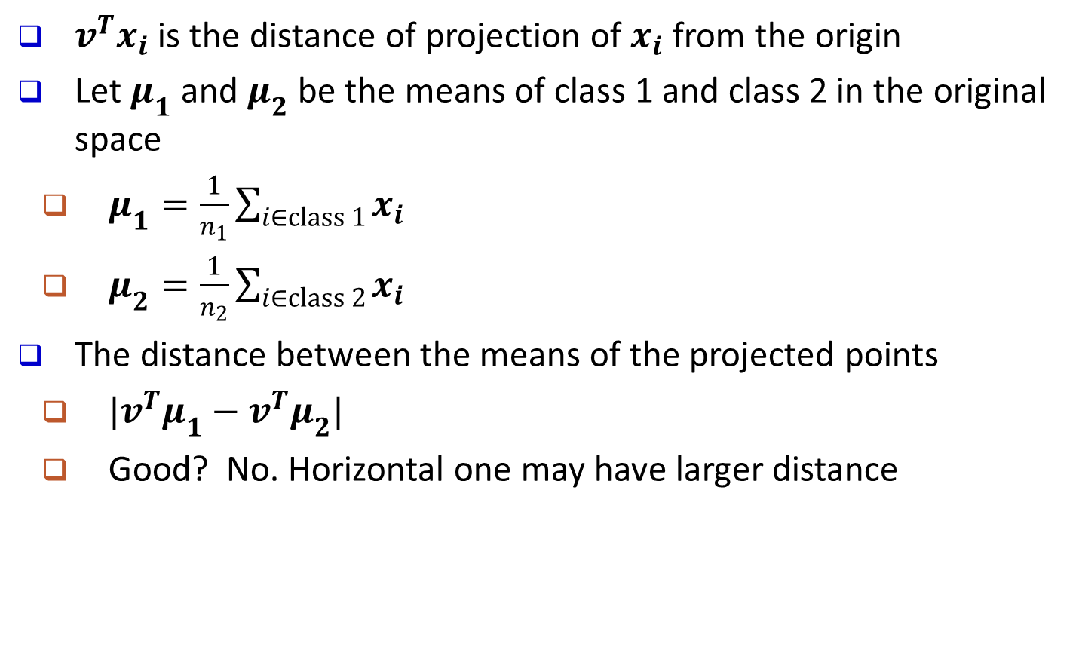
Fisher’s LDA (Linear Discriminant Analysis)
$v^{T}x_{i}$ is the distance of projection of $x_{i}$ from the origin
Let $μ_{1}$ and $μ_{2}$ be the means of class 1 and class 2 in the original space
$μ_{1}=\frac{1}{n_{1}}\sum_{i∈class 1}{x_{i}}$
$μ_{2}=\frac{1}{n_{2}}\sum_{i∈class 2}{x_{i}}$
The distance between the means of the projected points
$|v^{T}μ_{1}−v^{T}μ_{2}|$
Good? No. Horizontal one may have larger distance

Slide 105
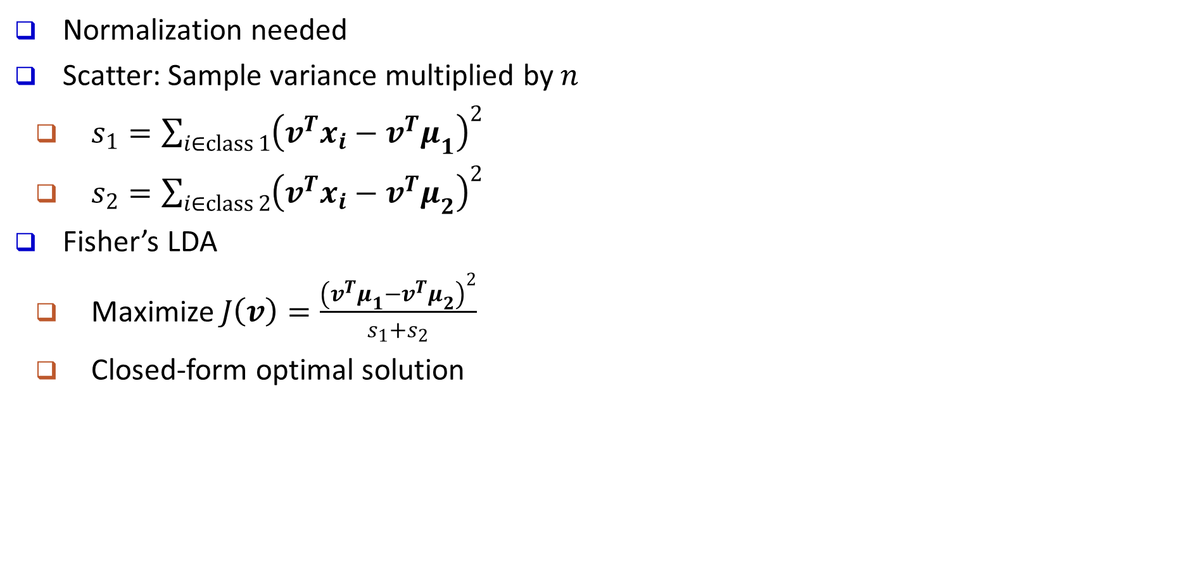
Fisher’s LDA (con’t)
Normalization needed
Scatter: Sample variance multiplied by $n$
$s_{1}=\sum_{i∈class 1}{{\left(v^{T}x_{i}−{v^{T}μ}_{1}\right)}^{2}}$
$s_{2}=\sum_{i∈class 2}{{\left(v^{T}x_{i}−v^{T}μ_{2}\right)}^{2}}$
Fisher’s LDA
Maximize $J\left(v\right)=\frac{{\left(v^{T}μ_{1}−v^{T}μ_{2}\right)}^{2}}{s_{1}+s_{2}}$
Closed-form optimal solution
Smaller Scatter
Bigger
Scatter

Slide 106
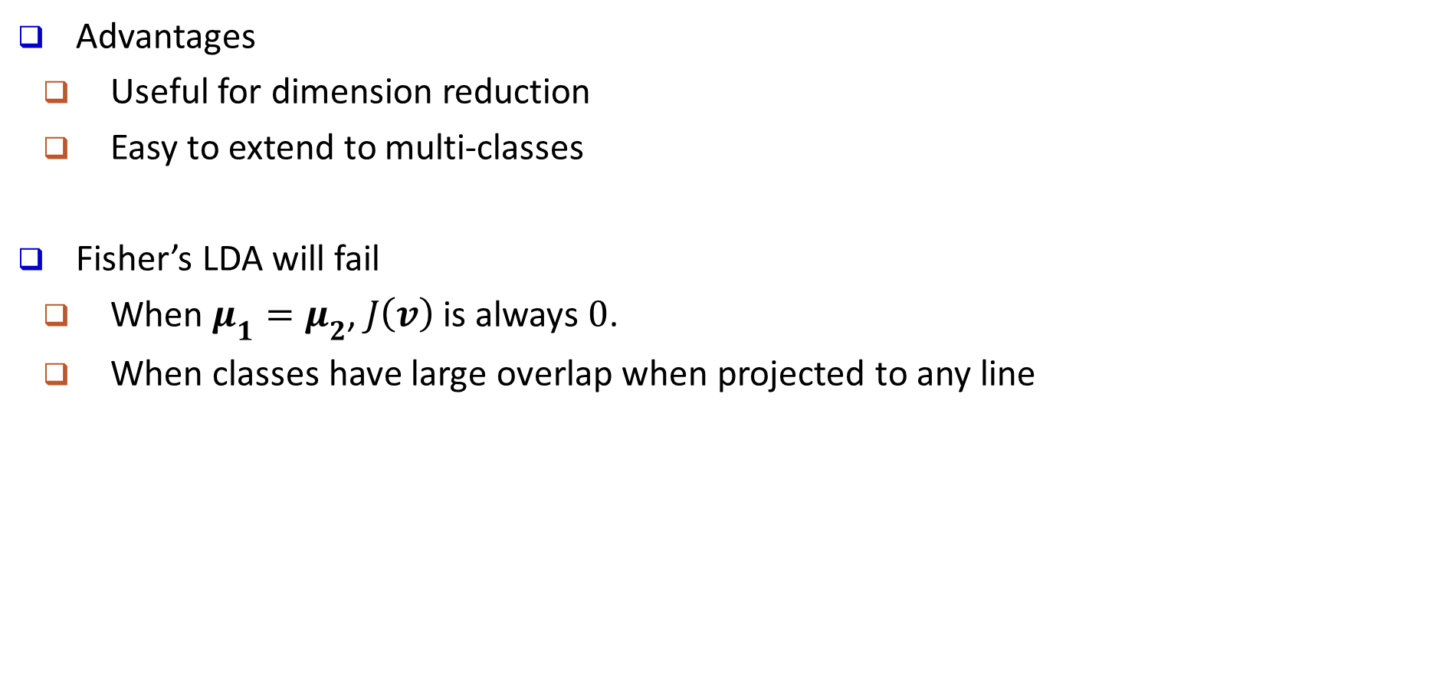
Fisher’s LDA: Summary
Advantages
Useful for dimension reduction
Easy to extend to multi-classes
Fisher’s LDA will fail
When $μ_{1}=μ_{2}$, $J\left(v\right)$is always $0$.
When classes have large overlap when projected to any line

